Slide 1
Safe Cervical Tumor Removal Using a Curved Bone Removal Instrument
John Peloza, M.D.
Hani Malone, M.D.
Michael Millgram, M.D.
Richard Guyer, M.D.
Ran Harel, M.D.
Scott Kutz, M.D.
Ely Ashkenazi, M.D.

Slide 2
Disclosures
J. Peloza, H. Malone: None.
M. Millgram, R. Guyer, R. Harel, S. Kutz: Consultants for Carevature Medical Ltd.
E. Ashkenazi: Consultant and shareholder for Carevature Medical Ltd.

Slide 3
Introduction
Surgical treatments to the upper cervical levels hold the risk of significant complications due to their proximity to vital blood vessels, nerves and the esophagus.
The dimensions and shape of surgical tools, such as the straight high-speed drill, dictate the required access route to the treated region.
In order to avoid unsafe approaches and to facilitate a safer access route to the tumor, the surgeon may choose to drill through healthy tissues. However, the removal of supporting bone structures may lead to spinal instability and require spinal fusion, thus complicating patient recovery.

Slide 4
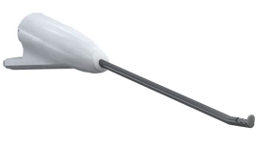
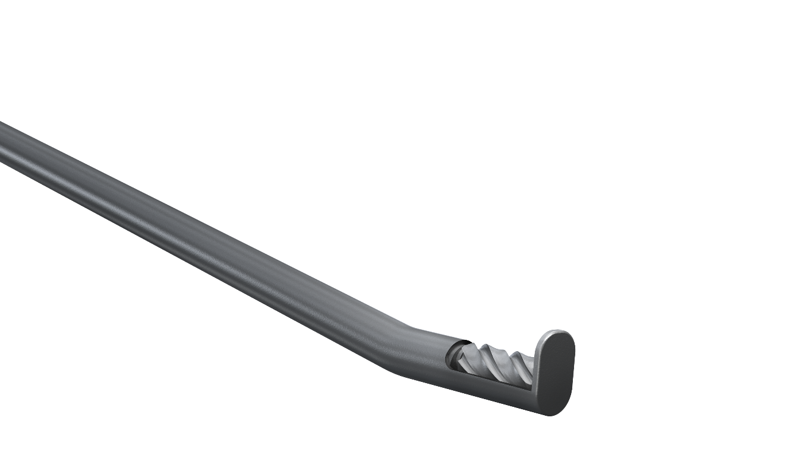
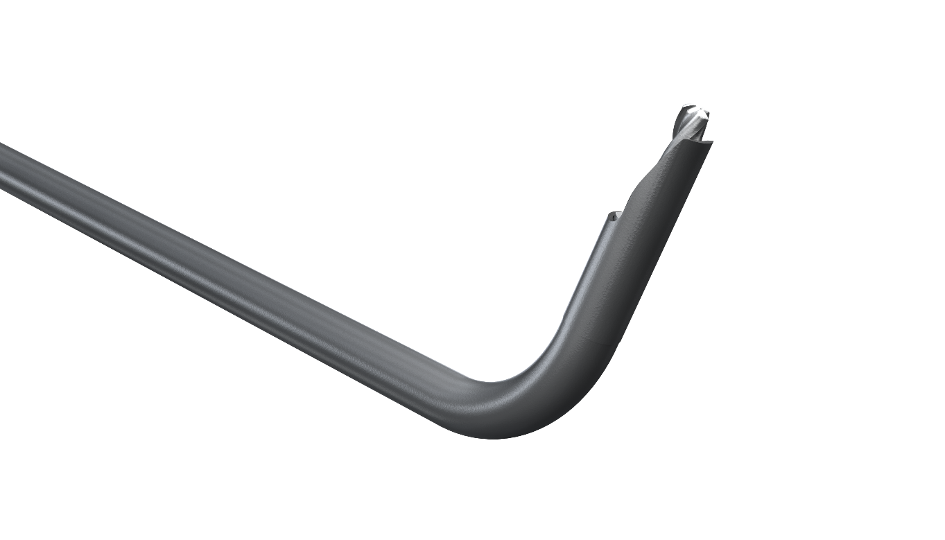
Introduction
The device
A recently developed curved-tip drilling device offers a potential solution to this problem.
The device allows the surgeon to reach difficult-access areas with minimal bone-removal.
The use of this device is demonstrated in a tumor resection procedure.
Drill tips

Slide 5
Case Presentation
62-year-old male without prior spine surgeries
A C2 vertebral tumor was observed a pre-operative CT scan before a planned anterior cervical discectomy and fusion (ACDF) procedure on the C5-C6 vertebrae
The tumor's location at the anterior part of the vertebra and its proximity to neural structures complicated its surgical removal using traditional tools and required extensive removal of healthy tissue.

Slide 6
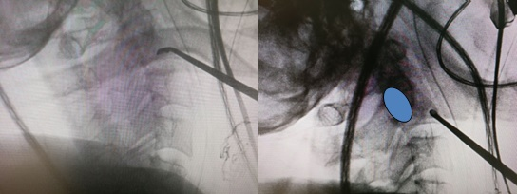
Case Presentation
During the C5-C6 ACDF surgery, the surgeon noticed an opportunity to safely remove the tumor using the curved device with minimal damage to healthy tissues.
The curved device allowed the surgeon to use the ACDF incision for the tumor removal
Intra-operative O-Arm imaging of the device.
- the tumor

Slide 7
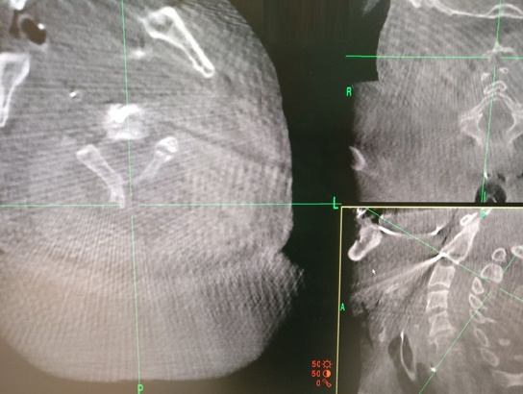
Results
The procedure was uneventful and without complications.
The entire tumor was successfully removed in two minutes, as shown in the O-arm images
The total operation length was 63 minutes, and the estimated blood loss was 200ml.
Histopathological examination revealed characteristic eosinophilic granuloma.
The patient was hospitalized for five days and released without further complaints.

Slide 8
Conclusion
The curved bone removal device facilitated a safe, quick and efficient removal of the vertebral tumor without removal of healthy surrounding tissues, thus sparing the patient from potential spinal instability.

