Slide 1
Telehealth for Outpatient Spine Consultation: Perspectives from the Initial COVID-19 Experience
Michael Craig, Oliver Lasry, Akash Chopra, Tamir Ailon
University of British Columbia

Slide 2
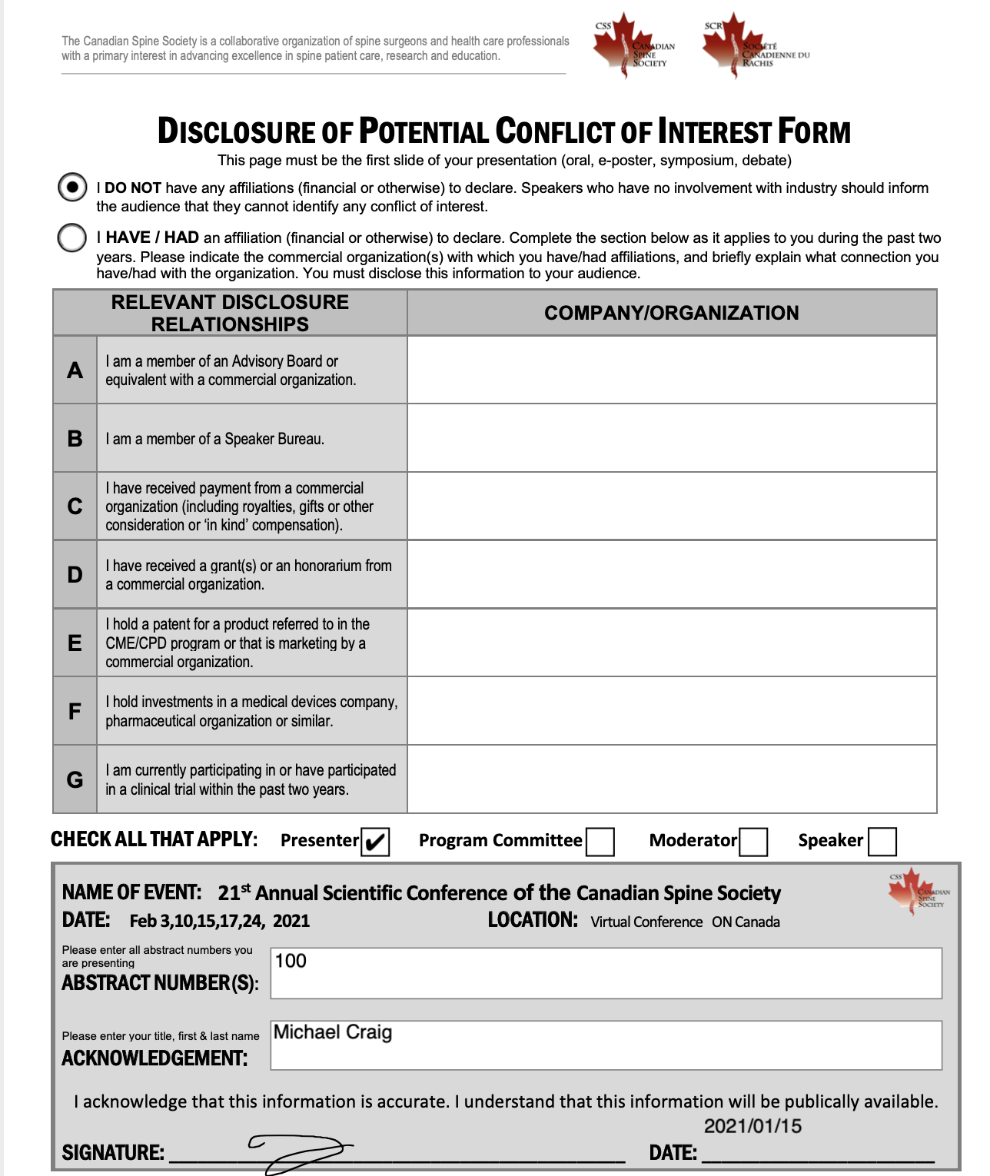

Slide 3
Background
In Canada, use of tele-health was growing substantially even before the COVID-19 pandemic
Prospective tele-health users may differ in their comfort level or satisfaction with the technology, and this may be linked to disease characteristics, demographics, or geography
We aimed to identify patient-specific characteristics associated with a favourable tele-health experience in those patients undergoing outpatient spine consultation

Slide 4
Methods
We enrolled consecutive patients undergoing outpatient spine consultation in the province of British Columbia during the initial months of the COVID-19 pandemic
We used an online patient-reported survey that collected demographic and disease-specific information, as well as validated outcome measures including VAS pain scale, ODI, and NDI. Survey items also assessed the technical details of the telehealth consultation and the patients' perspectives of that experience.

Slide 5
Methods
We assessed for any association between patient satisfaction and patient characteristics and disease severity. We also summarized patients’ qualitative responses regarding their impressions of their telehealth experience.
Univariate analyses were carried out comparing PROs in satisfied vs unsatisfied patients using the Mann-Whitney U test for nonparametric data at p < 0.05.
A multivariate analysis was planned to assess for any effect of PROs or telehealth-specific factors on satisfaction
Qualitative responses regarding tele-health were grouped into themes and tabulated

Slide 6
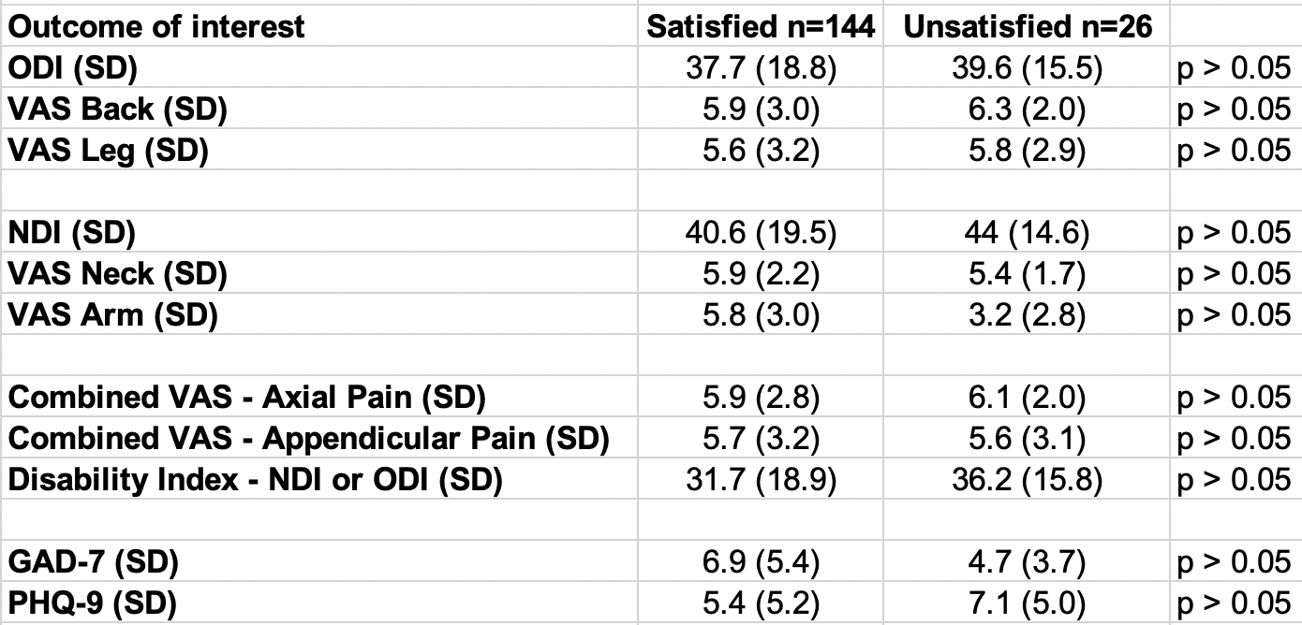
Results
170 unique responses obtained, of which 144 (84.7%) were ”satisfied” (very/somewhat/neutral) and 26 (15.3%) were “unsatisfied” (very/somewhat). Groups were comparable in terms of age, gender, education level, work status, and primary complaint (cervical vs lumbar).

Slide 7
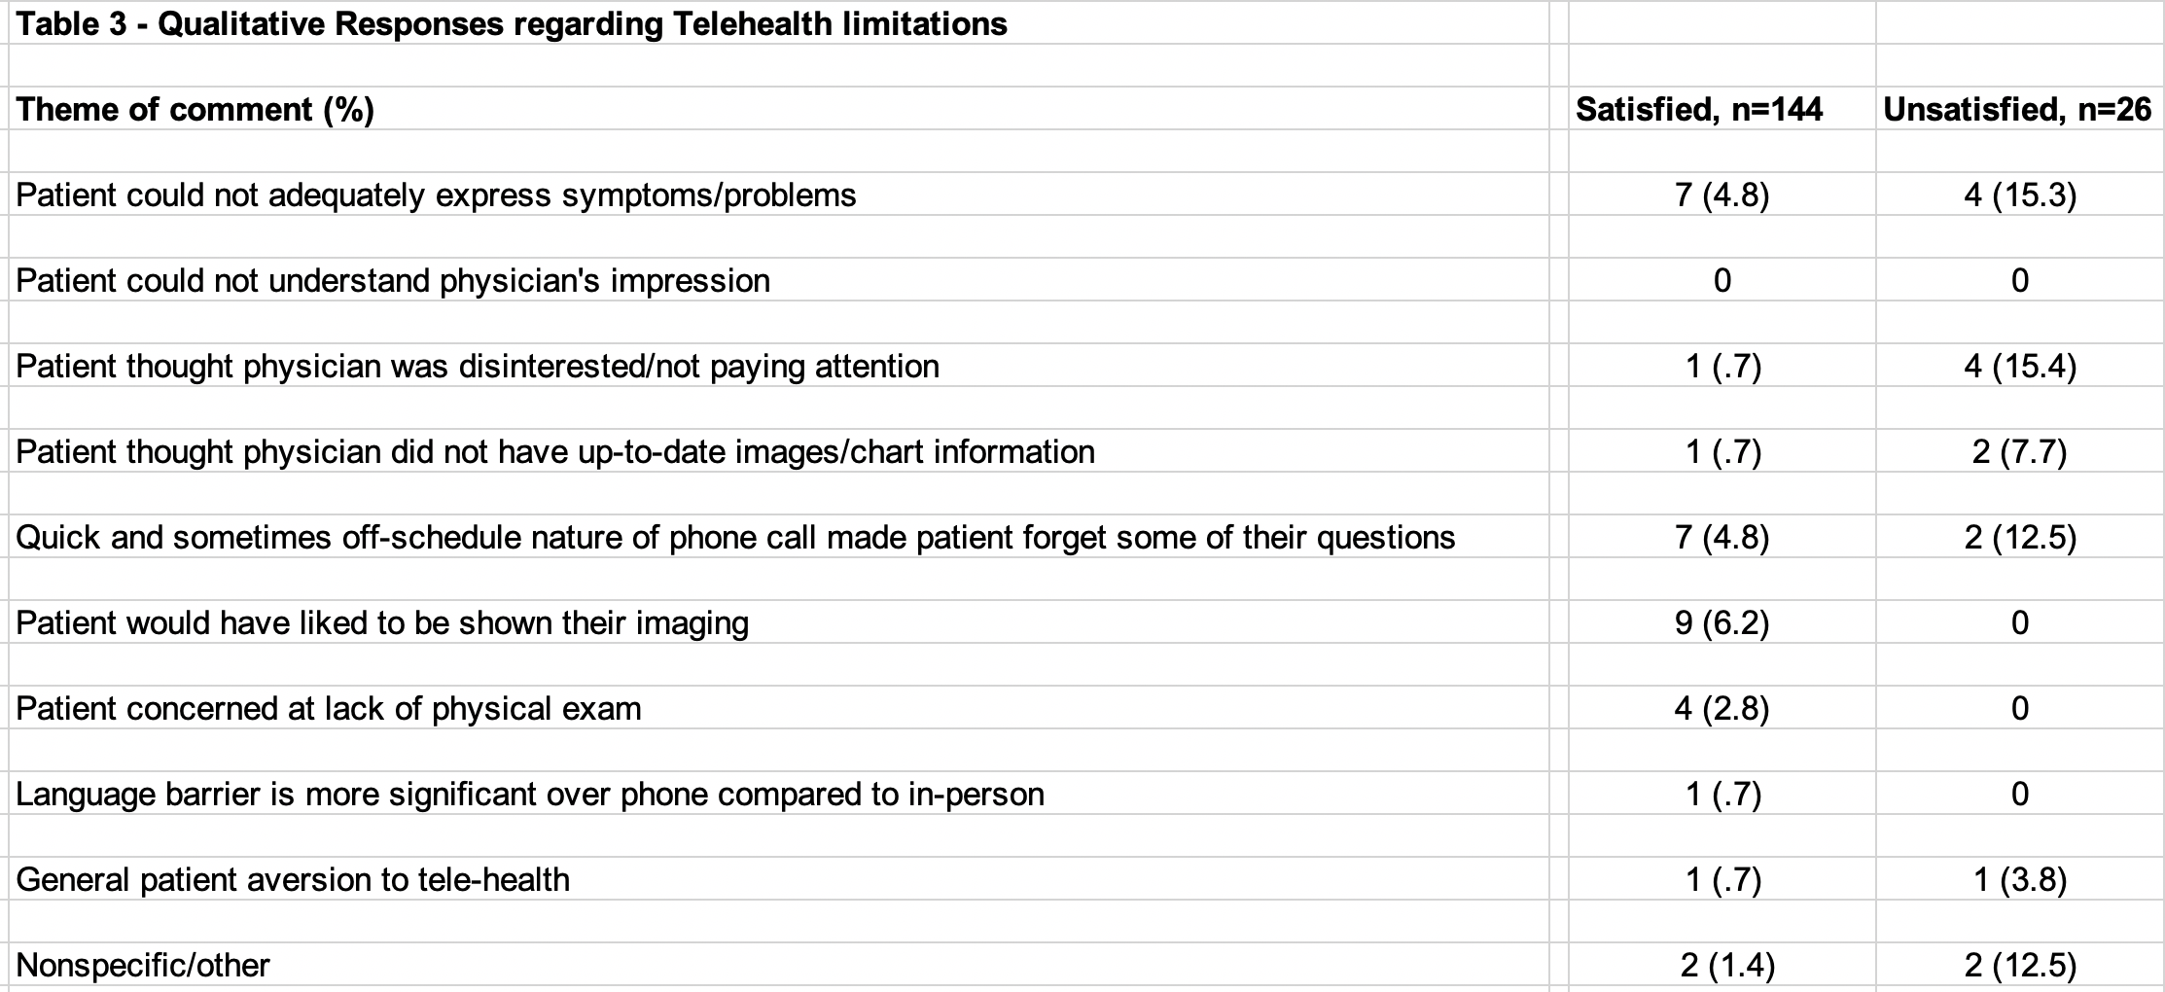
RESULTS
“Before I knew it, the call was over and I felt like I missed something or didn't get to ask all that I wanted”
"it was hard to get across what is causing me pain and where.”
“I find this forgetfulness when under time pressure interferes with my visits especially over the phone”

Slide 8
Summary
Most patients (84.7%) reported general satisfaction with tele-health for outpatient spine consultation
No clear differences in disease status/severity when comparing those satisfied and dissatisfied with tele-health
Statistical power limited by low proportion of unsatisfied patients
Qualitative results suggest patients may be most concerned with ability to express their symptoms as opposed to other aspects of the clinical interaction

