Slide 1
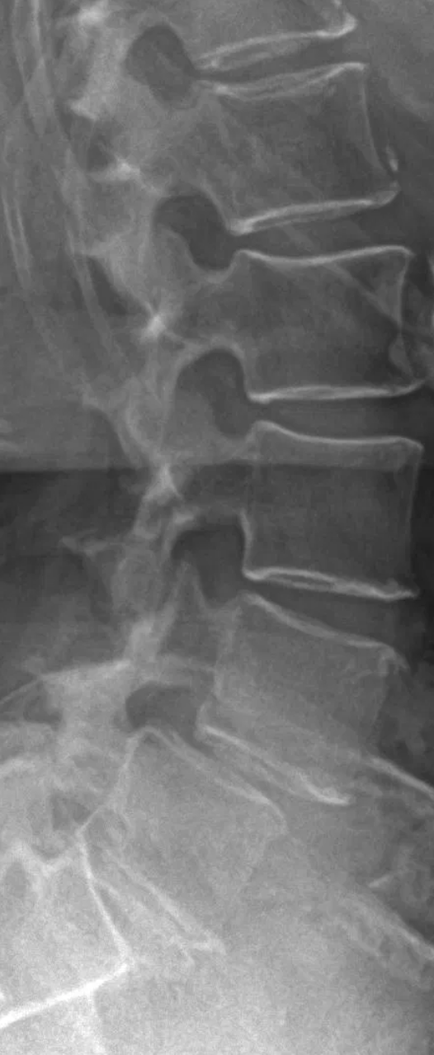
The Effect of Frailty on 30-day Morbidity in Patients Treated for Lumbar Spondylolisthesis Using a Posterior Surgical Approach
Canadian Spine Society 2021 Virtual Conference
Vivien Chan, MD; Christopher D Witiw, MD FRCSC; Jamie RF Wilson, MD FRCSC; Jefferson R Wilson, MD FRCSC; Michael G Fehlings, MD FRCSC
University of Alberta Division of Neurosurgery PGY5
University of Toronto Department of Surgery (Surgeon Scientist Training Program)
UTSpine Program
Institute of Medical Science (MSc) Program, Year 2

Slide 2
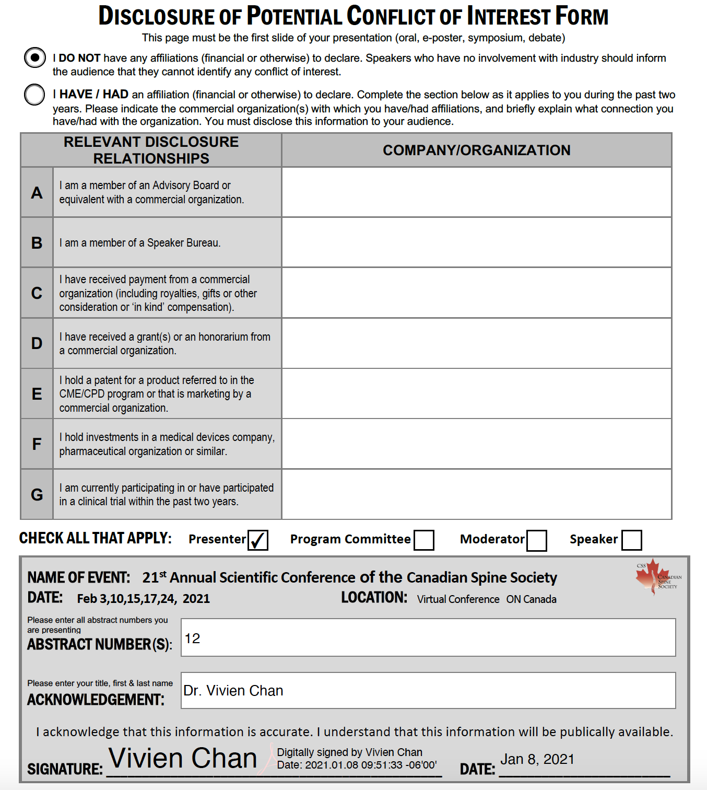

Slide 3
Background and Purpose
With an aging population, spine surgeons are encountering elderly patients with spine pathology more often^{1,2}
Traditionally, a more conservative approach favoured for elderly patients with lumbar spondylolisthesis due to a perceived higher risk of morbidity³⁻⁷
Studies based on age have been conflicting with arbitrary age cut-offs
Frailty may be a better predictor of morbidity and mortality after surgery
Purpose:
To investigate how frailty (as measured by mFI-5) impacts the risk of 30-day morbidity in patients treated for lumbar spondylolisthesis using a posterior approach

Slide 4
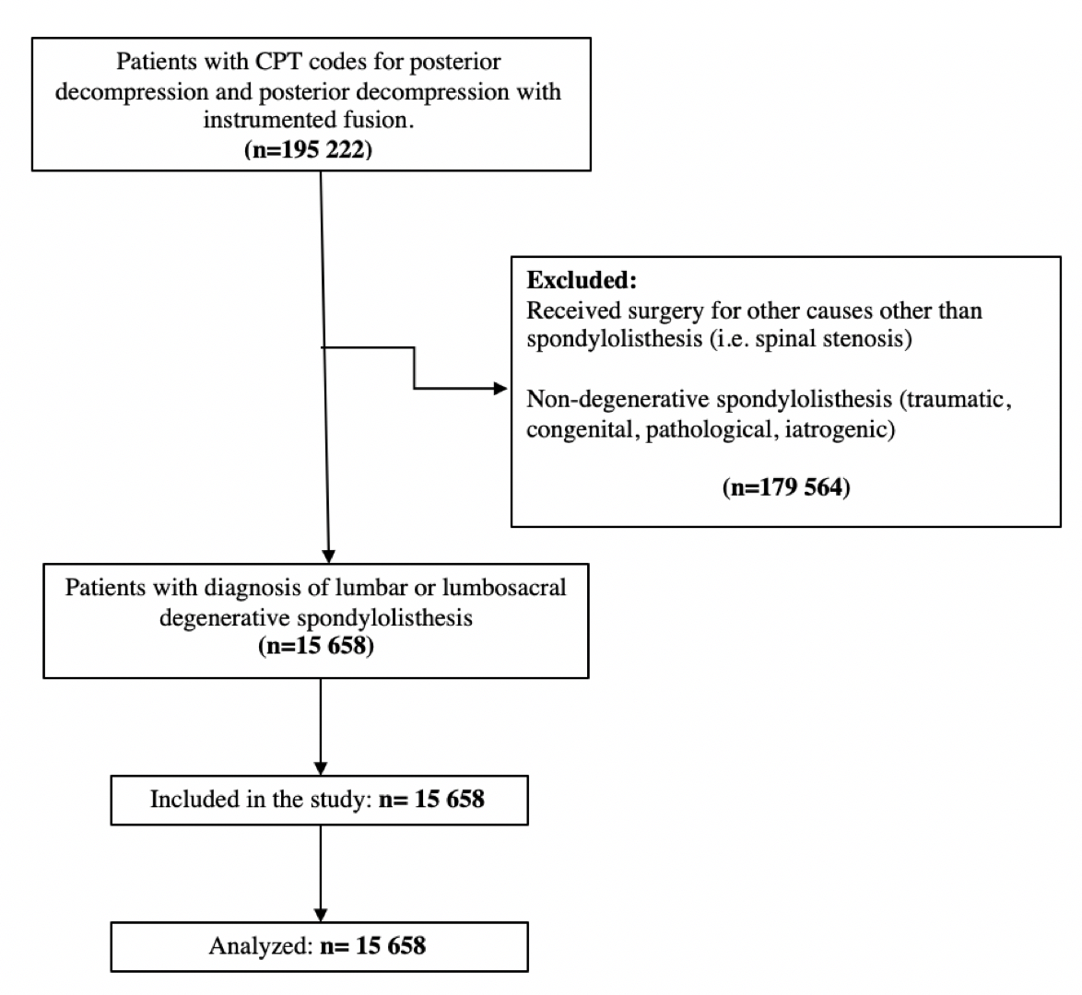
Methodology
Retrospective database study using The American College of Surgeons National Surgical Quality Improvement Program (NSQIP) database for years 2010-2018
Patients who received posterior lumbar decompression (CPT 63005, 63012, 63017, 63030, 63047) and lumbar spine decompression with posterior or posterolateral instrumented fusion (CPT 22612, 22630, 22633) for lumbar spondylolisthesis included in study
Primary outcome: Major complication within 30 days
Defined as Clavien-Dindo class IV surgical complications^{8,9}
Secondary outcomes: readmission, reoperation, non-home discharge
Figure 1. Flow diagram for inclusion and exclusion.

Slide 5
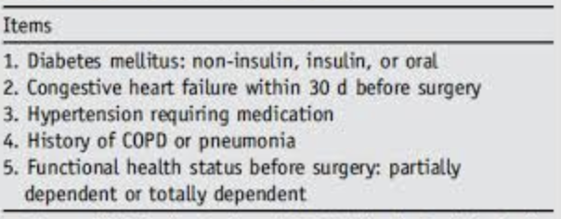
Methodology
mFI-5 used as a categorical variable¹⁰
Score 0 = non-frail
Score 1 = pre-frail
Score 2 = frail
Score ≥ 3 = severely frail
Descriptive statistics for patient demographics and outcomes
Multivariable logistic regression analysis between outcomes and age, sex, BMI, smoking status, mFI-5, and surgical procedure
Figure 2. Items included in 5-item modified frailty index.

Slide 6
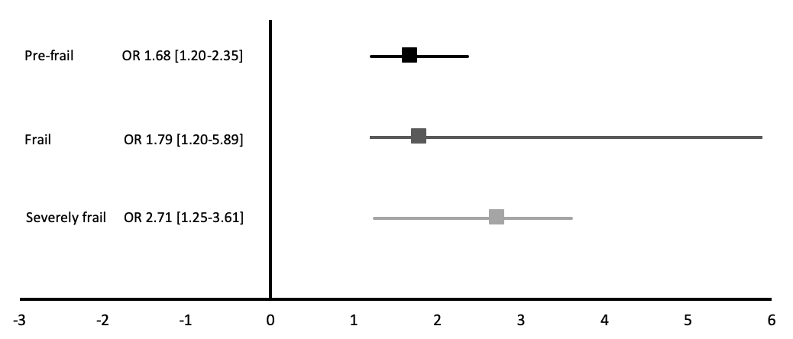
Results
n= 15 658
Mean age: 62.5
Female: 63.2%
Decompression 27.7%, Decompression with instrumented fusion 72.3%
Non-frail 36.8%, pre-frail 44.8%, frail 16.9%, severely frail 1.4%
Primary Outcome (Major Complication)
Frailty associated with increased risk of major complication. Risk increases with increasing frailty.

Slide 7
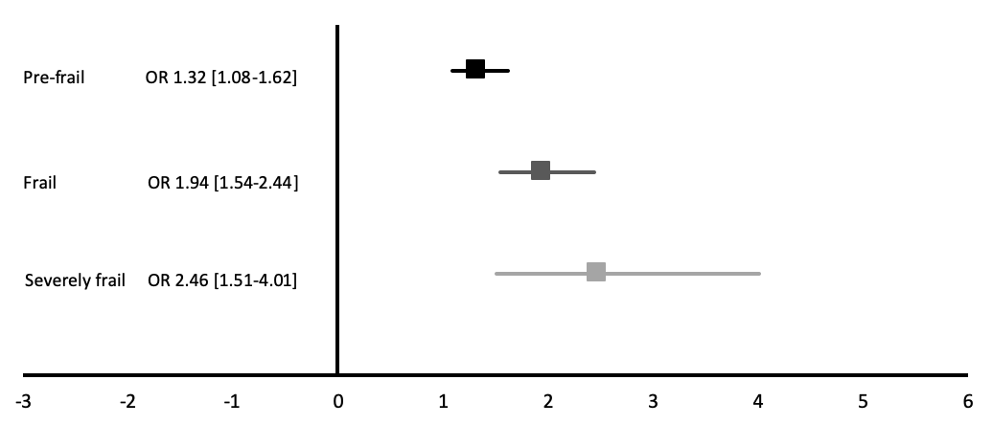
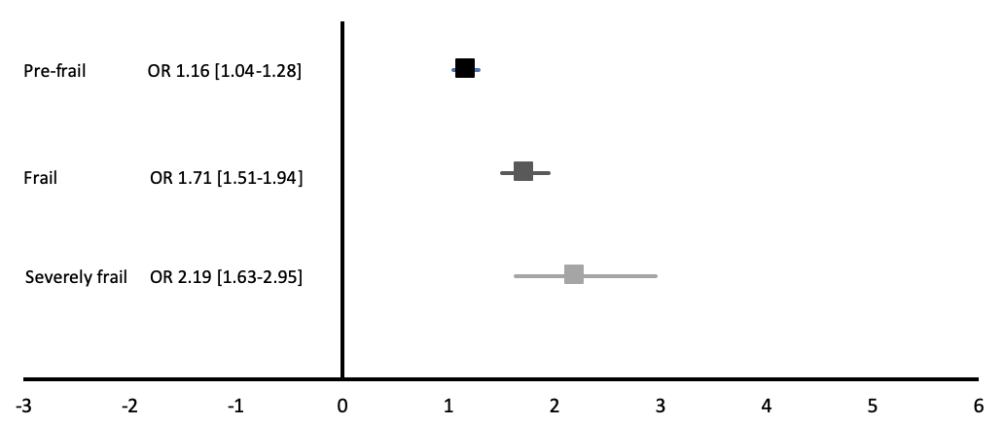
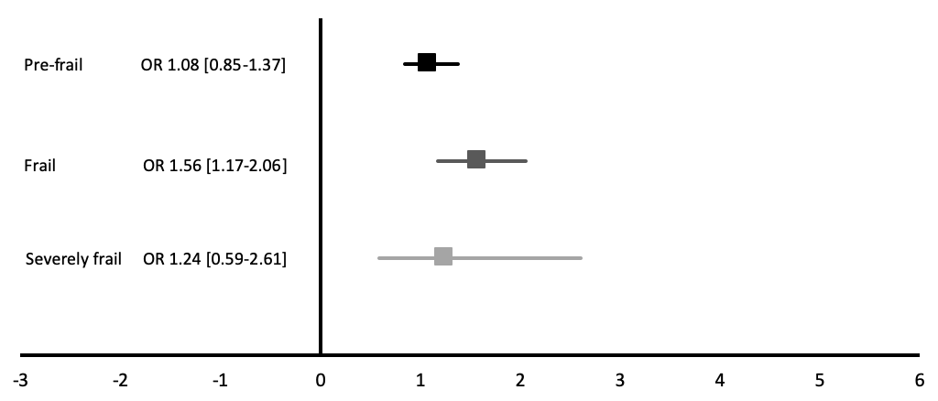
Results
Unplanned Readmission
Non-home Discharge
Reoperation
Frailty associated with increased risk of unplanned readmission, non-home discharge, and reoperation.

Slide 8
Conclusions
Frailty is an important factor for risk stratification for patients receiving surgery for degenerative lumbar spondylolisthesis
The risk of morbidity increases with increasing frailty
Compared to non-frail patients, likelihood of major complication 68% higher in pre-frail, 79% in frail, 171% in severely frail
Compared to non-frail patients, likelihood of readmission 32% higher in pre-frail, 94% in frail, 146% in severely frail
Compared to non-frail patients, likelihood of reoperation 56% higher in frail
Compared to non-frail patients, likelihood of non-home discharge 16% higher in pre-frail, 71% in frail, 119% in severely frail
Results from this study will aid in risk stratifying patients and future studies in prehabilitation

Slide 9
References
O'Lynnger, T. M., Zuckerman, S. L., Morone, P. J., Dewan, M. C., Vasquez-Castellanos, R. A., & Cheng, J. S. (2015). Trends for spine surgery for the elderly: implications for access to healthcare in North America. Neurosurgery, 77(suppl_1), S136-S141.
Kobayashi, K., Ando, K., Nishida, Y., Ishiguro, N., & Imagama, S. (2018). Epidemiological trends in spine surgery over 10 years in a multicenter database. European Spine Journal, 27(8), 1698-1703.
Schroeder, G. D., Kepler, C. K., Kurd, M. F., Vaccaro, A. R., Hsu, W. K., Patel, A. A., & Savage, J. W. (2015). Rationale for the surgical treatment of lumbar degenerative spondylolisthesis. Spine, 40(21), E1161-E1166.
Balabaud L, Pitel S, Caux I, Dova C, Richard B, Antonietti P, Mazel C. Lumbar spine surgery in patients 80 years of age or older: morbidity and mortality. European Journal of Orthopaedic Surgery & Traumatology. 2015 Jul 1;25(1):205-12.
Cloyd JM, Acosta Jr FL, Ames CP. Complications and outcomes of lumbar spine surgery in elderly people: a review of the literature. Journal of the American Geriatrics Society. 2008 Jul;56(7):1318-27.
Crawford III CH, Smail J, Carreon LY, Glassman SD. Health-related quality of life after posterolateral lumbar arthrodesis in patients seventy-five years of age and older. Spine. 2011 Jun 1;36(13):1065-8.
Marbacher S, Mannion AF, Burkhardt JK, Schär RT, Porchet F, Kleinstück F, Jeszenszky D, Fekete TF, Haschtmann D. Patient-rated outcomes of lumbar fusion in patients with degenerative disease of the lumbar spine: does age matter?. Spine. 2016 May 15;41(10):893-900.
Clavien, P. A., Sanabria, J. R., & Strasberg, S. M. (1992). Proposed classification of complications of surgery with examples of utility in cholecystectomy. Surgery, 111(5), 518-526.
Shin, J. I., Kothari, P., Phan, K., Kim, J. S., Leven, D., Lee, N. J., & Cho, S. K. (2017). Frailty index as a predictor of adverse postoperative outcomes in patients undergoing cervical spinal fusion. Spine, 42(5), 304-310.
Yagi, M., Michikawa, T., Hosogane, N., Fujita, N., Okada, E., Suzuki, S., ... & Nakamura, M. (2019). The 5-Item modified frailty index is predictive of severe adverse events in patients undergoing surgery for adult spinal deformity. Spine, 44(18), E1083-E1091.

Slide 10
Acknowledgement
Supervisors:
Dr. Michael Fehlings (Toronto Western Hospital)
Dr. Christopher Witiw (St. Michael’s Hospital)

