Slide 1
Lumbar Shortening: A Novel Surgical Technique for Lumbopelvic Fusion Following Total Sacrectomy Cherry, A., Oitment, C., Wunder, JS., Ferguson, PC., Rampersaud, R. University of Toronto, Toronto, Canada
Canadian Spine Society: 21st Annual Conference
February 2021

Slide 2
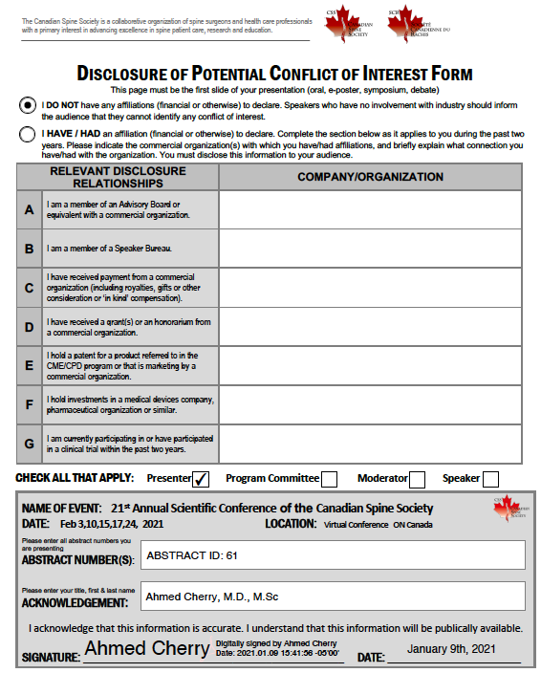

Slide 3
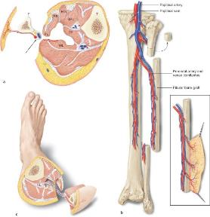
Introduction
Primary sacral tumors are rare, representing fewer than seven percent of spinal neoplasms.
Following sacrectomy, the risk of non-union is very high with current recommendations suggesting vascularized fibula grafts to improve bony union rates.
In this study, we describe the outcome of a novel technique following sacrectomy whereby primary lumbar shortening is performed, removing the need for allograft or vascularized autograft use.
Notes:
Tumors with a predilection for the sacrum include malignancies such as chordoma, chondrosarcoma and benign locally aggressive lesions such as giant cell tumor.
In this report, we describe the outcome of a novel technique following sacrectomy whereby lumbosacral shortening is performed, the L5 vertebrae is lowered between the two sides of the pelvis and the posterior pelvic ring is compressed using internal fixation to enable bilateral residual iliac contact with the native L5 vertebra.

Slide 4
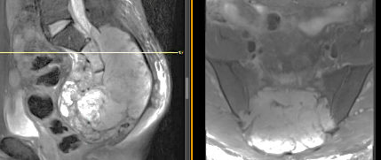
Methodology
Retrospective chart review of 2 patients treated by a single surgeon in our institution.
A review of hospital records included patient demographics, clinical assessments, complications, patient reported outcomes, and operating room, pathology and imaging reports.
Patient 1: 17 y.o. - Chondrosarcoma
Patient 2: 51 y.o. - Chordoma

Slide 5
Patient Demographics
Patient Number | Demographics | Presenting Complaint | Pre-operative Treatments | Pathology
1 | 17 M | Right lower extremity: subjective paresthesias/sciatica Penile/scrotal/peri-anal paresthesias Progressive left lower extremity neuropathic pain Lumbar back pain | Intralesional treatment: Sacral laminectomy S1-coccyx, with post-operative radiotherapy | Chondrosarcoma
2 | 51M | Chronic lower back pain Denies lower extremity neuropathic pain | Trial immunotherapy: PD-L1 inhibitor, FAZ053, combined with PD-1 inhibitor Radiotherapy | Low grade Chondroid Chordoma
Notes:
Patient Information
Patient 1: A 17-year-old male presenting with lumbosacral neuropathic pain and radiculopathy after a failed intralesional surgery and radiation for chondrosarcoma.
Patient 2: A 51-year-old male who presented with chronic low back pain caused by a large low-grade chondroid sacral chordoma.

Slide 6
Surgical Overview and follow up
Both patients underwent a multidisciplinary two stage procedure that included a pelvic exenteration with colostomy in both, and ileal conduit in one, at the first stage followed by posterior wide margin total sacral resection and instrumentation.
Reconstruction involved translating the remaining L5 vertebra into the pelvis and lumbopelvic instrumentation with closure of the posterior pelvic ring to obtain host bone-to-bone contact under compression, eliminating the need for vascularized bone grafts.
In addition to planned resection neurologic deficits, both patients had temporary L4 myotomal weakness with recovery over 2 years. Computed tomography (CT) scans showed solid bony fusion at three years and 18 months, respectively.
Both patients are doing well, with no evidence of tumor recurrence at seven and two-years’ follow-up.

Slide 7
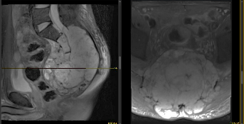
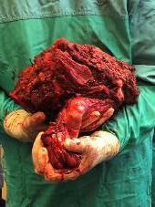
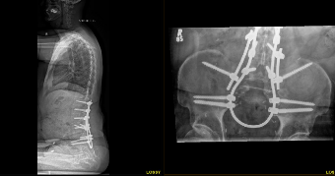
Patient 2 – 51M chordoma
**
Pre-operative
2 years post-operative
L5
*
*
Post-operative
* VRAM (Vertical rectus abdominis myocutaneous) flap
** L4 osseous bridging

Slide 8
Complications
Complication | Patient 1 | Patient 2
Intra-operative | Left S1 nerve root sacrifice | Right ureter transection – repaired by Urology
Surgical Site | Infection requiring 3x irrigation and debridement | Abdominal wound drainage - required negative pressure wound therapy and closure
Neurological | L4 motor deficit: left sided foot drop, right sided motor/sensory deficit Lower extremity neuropathic pain | N/A
Fusion/construct | Iliac screw loosening – no intervention required | N/A
Miscellaneous/ Medical: | Rifampin/L-thyroxine drug-drug interaction Hip pain – resolved spontaneously | GI bleed – required endoscopy DVT right leg and pulmonary embolism– treated with anticoagulation Cholecystitis – no intervention required Delirium – no intervention required Aspiration pneumonia – no intervention required
Notes:
Patient 2 – sacrificed cauda
L5 motor deficit: bilateral foot drop (planned)
Lower extremity neuropathic pain
Neurogenic bladder – required cystoscopy, Botulism Toxin Injection and intermittent catheterization

Slide 9
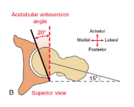
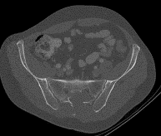
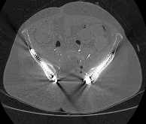
Alteration to Pelvic-Hip Anatomical Parameters
Patient Number |  | Pre-operative | Post-operative | 𝚫
1 | Left Hip* | 19.4 | 14.8 | -4.6
 | Right Hip* | 16.9 | 8.8 | -8.1
 | Anterior SI joint Distance (cm) | 11.5 | 8.4 | -3.1
2 | Left Hip* | 17.7 | 3.3 | -14.4
 | Right Hip* | 15.9 | 1.1 | -14.8
 | Anterior SI joint Distance (cm) | 13.2 | 9.0 | -4.2
*Acetabular Version (degrees)
* Anterior SI distance (cm)

Slide 10
Conclusion
Primary lumbar shortening represents a novel technique for structural spinopelvic reconstruction following total sacrectomy that obviates the additional morbidity and prolonged operative time required for vascularized fibula grafting

