Slide 1
The Use of Minimally Invasive Navigation Guided Resection of Spinal Osteoid Osteomas and Osteoblastomas ^{Cherry, A., Rampersaud, R.} University of Toronto, Toronto, Canada
Canadian Spine Society: 21st Annual Conference
February 2021

Slide 2
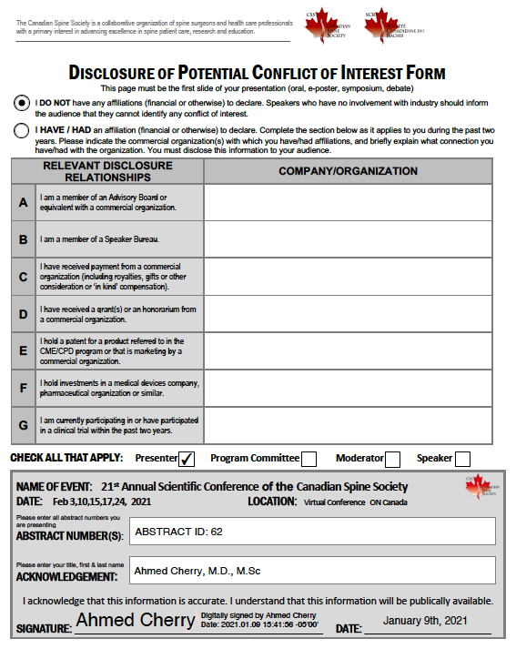

Slide 3
Introduction
Osteoid osteomas (OO) and osteoblastomas (OB) are benign bone lesions that typically involve the posterior elements. Due to anatomical location, they are often not amenable to Radiofrequency Ablation (RFA).
Complete intralesional resection of the nidus has been shown to be curative, however, often requires instrumented spinal fusion.
In this study, we sought to demonstrate the feasibility and efficacy of outpatient minimally invasive, navigation assisted, anatomy preserving resection for treatment of symptomatic spinal OOs and OBs.

Slide 4
Methodology
Retrospective chart review of six patients treated by a single surgeon in our institution between 2018 and 2020.
Chart review included patient demographics, pre-operative clinical assessments, treatment complications, and follow-up clinical outcomes.
Indication for operative intervention was a confirmed lesion on pre-operative computed tomography (CT) with clinical symptoms in keeping with OO or OB.

Slide 5
Patient Data
Case Number | Demographics | Symptoms at presentation | Pre-operative biopsy | Previous intervention | Tumor location
1 | 21, Male | Nine-month history lumbar and anterior thigh pain | N/A | N/A | Right L3 vertebral body
2 | 20, Male | Two-year history pain with right sided radiculopathy | N/A | L5 nerve root corticosteriod injection with 5-month symptom improvement in radiculopathy | Right L4 inferomedial pedicle and posterior vertebral body
3 | 36, Female | Five-year history back pain | N/A | N/A | Right inferior T2 articular process
4 | 26, Male | Two-year history back pain | OO/OB | N/A | Left S2 dorsal vertebral body and lamina
5 | 20, Female | Two-year history back pain, loss of ROM | N/A | Radio-ablation x 2 (Nil improvement) | Left L5 dorsal pars
6 | 25, Female | Six-year history back pain, loss of ROM | N/A | IR intervention with T7-T9 medial branch block Radio-ablation April 2019 with no improvement | Right T8 Inferior facet
Notes:
The patient cohort comprised of three males and three females with an average age of 25.4 years.
All six patients reported axial spine pain that was worse at nighttime, with stiffness and radiculopathy noted in two patients. Symptom duration ranged from nine to 72 months.
Pre-operative CT identified lesions localized to the articular facet (three), vertebral body (two) and sacral body (one).
Two patients had previous failed RFA.
Average operative time was 99.2 (65-154) minutes with no patients requiring instrumentation or admission.

Slide 6
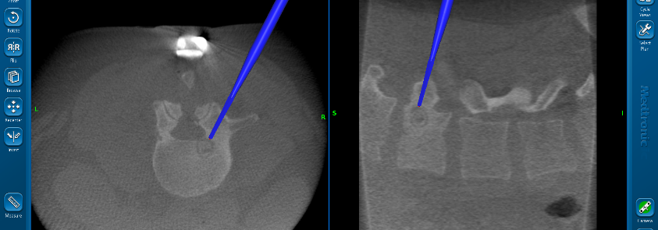
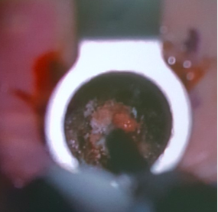
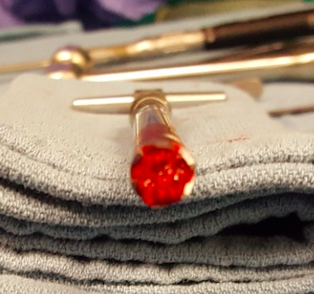
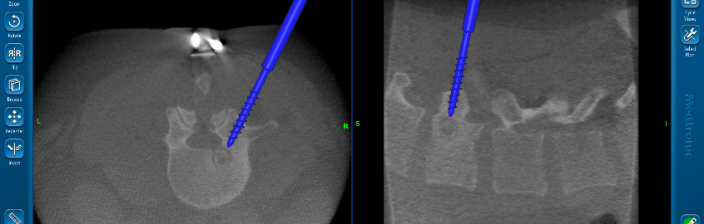
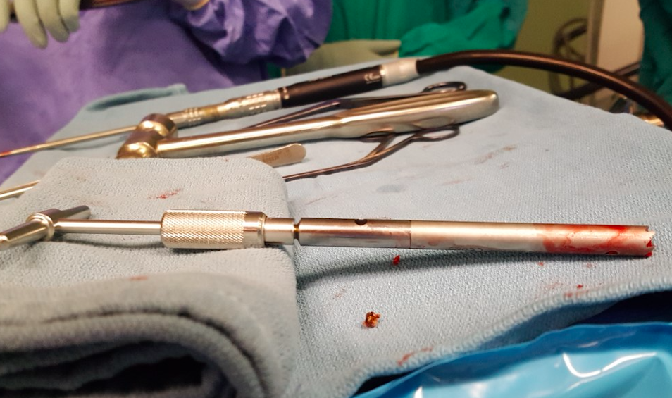
Intra-operative Technique (Case 1)
Intra-operative navigation
O-arm intra-operative imaging

Slide 7
Intra-operative Summary
Case Number | Procedure | EBL | LOS (min)
1 | Transpedicular excision of right L3 vertebral body OO | “Minimal” | 100
2 | Partial right L4 corpectomy, medial pedicle resection, L4 neurolysis and OO resection | 50 cc | 154
3 | Right T2 articular process en bloc resection | 50 cc | 76
4 | S1 to S2 OO resection and decompression of S1 /S2 nerve roots | 300 cc | 135
5 | Osteotomy of inferior L4 facet and OO L5 resection | “Minimal” | 65
6 | Resection T8 inferior facet osteoid osteoma, unilateral decompression. | “Minimal” | 65
Notes:
Average operative time 99.2 mins
There were no reported peri-operative complications and all had resolution of their primary back-focused pain at the first six-week post-operative follow up. Three patients reported subjective lumbar stiffness.
One patient exhibited S1/S2 paresthesias immediate post-operatively with resolution at six weeks. One patient was found to have questionable recurrence of nidus on CT seven months post-operatively. He reported only mild back stiffness with resolution of pre-operative symptoms. No patients had significant changes to alignment or stability identified on post-operative x-rays.

Slide 8
Conclusion
Outpatient navigation guided minimally invasive targeted resection, without fusion is a feasible and effective treatment in the short-term for symptomatic spinal OO and OB

Slide 9
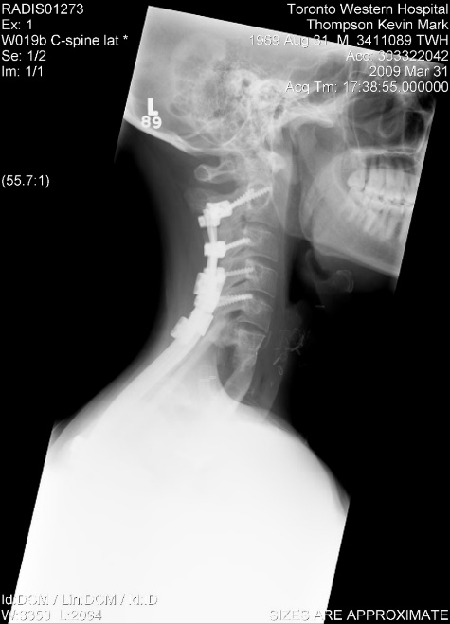
Conclusion
In highly selected patients, revision en-bloc resection for malignant primary spinal tumors after inappropriate index intralesional surgery is achievable with good long-term outcomes.
Patient 2: Osteosarcoma
at 10 years post- revision

