Slide 1
Survival Following Revision En-bloc Resection after Index Intralesional Procedure for Primary Malignant Spinal Tumors ^{Cherry, A., Rampersaud, R.} University of Toronto, Toronto, Canada
Canadian Spine Society: 21st Annual Conference
February 2021

Slide 3
Introduction
Negative margin en-bloc resection of primary malignant tumors involving the spine is the recommended treatment to provide patients with the best odds of long-term disease-free survival.
In addition to higher recurrence and poorer survival rate, an index intralesional procedure (IIP) creates additional challenges for achieving a margin negative revision resection.
In this report, we describe the outcomes for ten patients who underwent revision resection with en-bloc intent following IIPs for primary malignant spinal tumors.

Slide 4
Methodology
Retrospective chart review of ten patients treated by a single surgeon in our institution between who underwent IIPs.
A review of hospital records included patient demographics, clinical assessments, complications, patient reported outcomes, and operating room, pathology and imaging reports.

Slide 5
Case Number | Demographics | Presenting Symptoms | Surgical Pathology at Intralesional Procedure | Post-operative Neurological Status
1 | 51 Female | Radiculopathy | Osteosarcoma | Resolved
2 | 37 Male | Myelopathy | Osteosarcoma | Resolved
3 | 23 Male | Lower Extremity Paralysis | Ewing’s Sarcoma | Improved with residual HF weakness and gait imbalance
4 | 57 Male | Dysphagia | Chordoma | Improved swallowing
5 | 18 Male | Cauda equina | Chondrosarcoma | Resolved
6 | 19 Male | Lower Extremity Paralysis | Ewing’s Sarcoma | Resolved
7 | 35 Male | Radiculopathy | Spindle Cell Sarcoma | Improved with residual sensory deficit
8 | 32 Female | Myelopathy | Chondrosarcoma | Improved with :L5 sensory deficit
9 | 46 Female | Radiculopathy | Sclerosing Epithelioid Fibrosarcoma | No change
10 | 35 Male | Lower Extremity Paralysis | Leiomyosarcoma | Improved

Slide 6
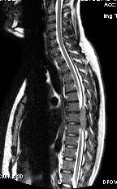
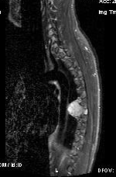
Patient 3 – Ewing’s Sarcoma
23-year-old with grade 3-4 L/E motor strength and T7/8 sensory level
Pre-operative

Slide 7
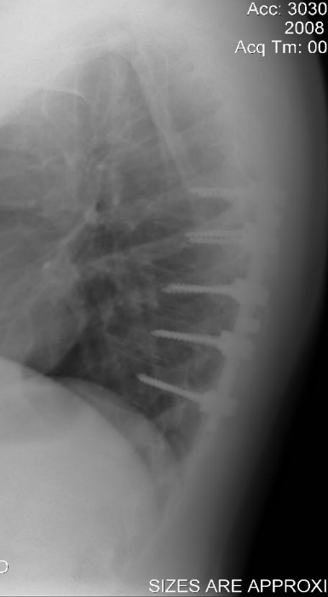
Intra-lesional Procedure
Post-operative

Slide 8
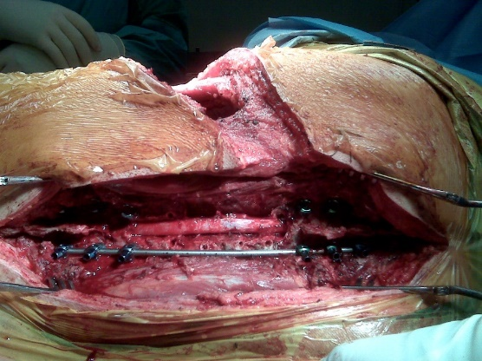
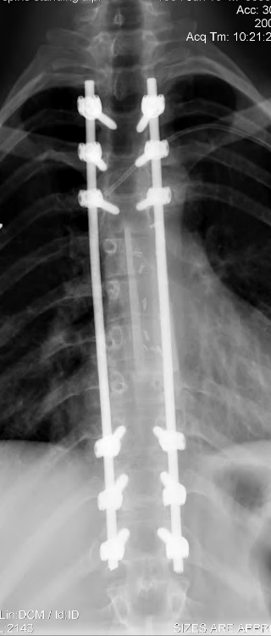
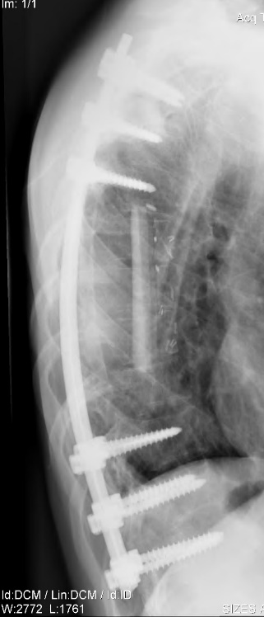
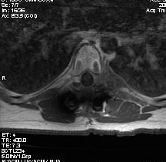
Chemotherapy and Revision Surgery
Pre-Chemo
Post-Chemo

Slide 9
Case Number | Adjunctive Treatment |  | Number of Stages | Pathology Margins | Oncological Outcome/ Recurrence | Complications | Follow up
 | Chemo | Rads
(1) Osteosarcoma | Y | Y | 2 | Negative | No recurrence | None | 12 years
(2) Osteosarcoma | Y | N | 2 | Negative | No recurrence | Aspiration pneumonia Esophageal erosion Ant graft resorption Unilateral vocal cord paralysis | 12 years
(3) Ewing’s Sarcoma | Y | Y | 2 | Negative | No recurrence | None acute Fractured rod after fall; revised | 12 years
(4) Chordoma | N | N | 2 | Positive -Ant scar | Local at 7 years | CSF leak Would infection and sepsis Junctional kyphosis; revised Chronic pain | 7 years
(5) Chondrosarcoma | N | Y | 2 | Negative | No recurrence | Wound infection x 2; OR Neurogenic bladder Late wound infection; OR + Abx | 6 years
(6) Ewing’s Sarcoma | Y | Y | 1 | Negative | Metastatic @ 3 months | Pleural effusion | N/A
(7) Spindle Cell Sarcoma | Y | Y | 1 | Negative | No recurrence | None acute Fractured ROD; revised | 6 years
(8) Chondrosarcoma | N | N | 1 | Negative | No recurrence | None | 5 years
(9) Sclerosing Epithelioid Fibrosarcoma | N | Y | 1 | Negative | No recurrence | Wound issues, VAC therapy Fracture L2 screw; revised | 3 years
(10) Leiomyosarcoma | N | Y | 1 | Negative | No recurrence | TRALI Foot drop | 11 years
Notes:
Average age was 36.6 years with seven males and three females.
Seventy percent of IIPs occurred in Ontario academic institutions. Indication of IIP included presentation to the emergency department with neurological deficit from cord (four) or cauda equina compression (one); radiculopathy (three); myelopathy (one); and dysphagia (one).
A potentially positive dural margin was planned in eight patients and a wide resection in two. Five patients required multi-staged procedures. The resection margins were negative in nine patients.
Sixty-percent had peri-operative adverse-events with three requiring return to operating room. Fifty percent had late complications including non-union with rod breakage; allograft resorption; screw loosening; junctional kyphosis, and an esophageal erosion.
At final follow-up (mean 6.8 years) one patient died of early metastasis (Ewing’s sarcoma) and one had local recurrence at seven years and again at four years post return to operating room (margin positive Chordoma). The remaining seven patients are disease free at a mean of 8.1 years.

Slide 10
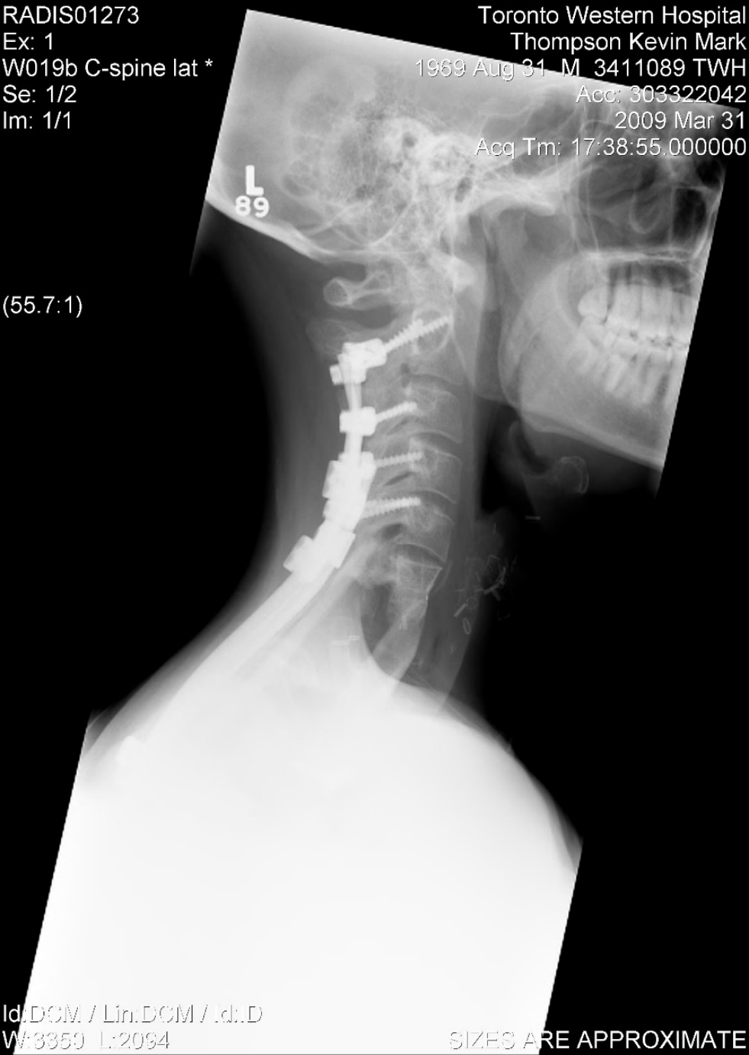
Conclusion
In highly selected patients, revision en-bloc resection for malignant primary spinal tumors after inappropriate index intralesional surgery is achievable with good long-term outcomes.
Patient 2: Osteosarcoma
at 10 years post- revision

