Slide 1
FACTORS ASSOCIATED WITH INCREASED LENGTH OF STAY IN DEGENERATIVE LUMBAR SPINE SURGERY: COHORT ANALYSIS FROM THE CANADIAN SPINE OUTCOMES AND RESEARCH NETWORK (CSORN)
CHARLOTTE DANDURAND, ADULT SPINE FELLOW, VANCOUVER GENERAL HOSPITAL, UNIVERSITY OF BRITISH COLUMBIA
COMBINED NEUROSURGICAL AND ORTHOPEDIC SPINE PROGRAM
PI: DR RAPHAEL CHAREST-MORIN
No conflict of interest to declare

Slide 2
BACKGROUND
Extended length of stay (LOS)
increases health costs
Increases postoperative compliations
Increases hospital resources utilization
LOS important measure of patient outcomes
Notes:
Extended hospital length of stay (LOS) after elective spine surgery contributes significantly to health care costs. The objectives of this study were to report on variability of LOS in Canada for commonly performed lumbar spine procedures and to determine patient and surgical predictors of increased LOS.

Slide 3
PURPOSE OF RESEARCH
Primary objective :
Examine LOS in multiple center across Canada
Secondary objective :
Identify factors associated with extended LOS with multivariate model

Slide 4
METHODS: DATA SOURCE
Canadian Spine outcomes and Research Network (CSORN)
National health data registry
13 sites
January 2015 to October 2020

Slide 5
METHODS: STUDY POPULATION
Inclusion :
Lumbar surgery from L1-S1
Discectomy of 1-2 levels
Lumbar laminectomy of 1-2 levels
Posterior fusion of 5 levels or less.
Exclusion criteria :
revision surgery
emergency surgery
deformity diagnosis
combined anterior-posterior approach.

Slide 6
METHODS: VARIABLES DESCRIPTION
LOS
Number of calendar days from operation to hospital discharge
Patient with longer LOS than median included in multivariate analysis
Predictors
Age, marital status, comorbidities, back pain scale, (ODI), operative time, estimated blood loss, perioperative adverse events (AE), intraoperative AE and minimally invasive surgery (MIS).

Slide 7
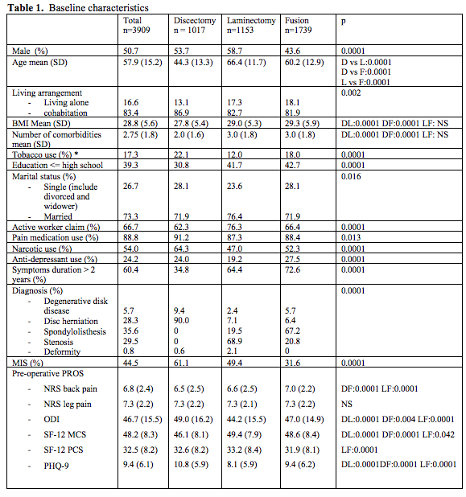
RESULTS : PATIENT POPULATION

Slide 8
RESULTS : LENGTH OF STAY

Slide 9
RESULTS : PREDICTORS ON MULTIVARIATE ANALYSIS
Discectomy : 377 patients
Older age, non-smoker, symptoms duration over 2 years duration, less leg pain, higher ODI, longer OR time, more blood loss, peri-op, intra-operative AE, no MIS.
Laminectomy : 418 patients
Older age, not married, higher ODI, longer OR time, more blood loss, peri-op AE, no MIS.
Fusion : 570 patients
older age, not married, more comorbidities, less back pain, higher ODI, longer OR time, more blood loss, peri-op AE, intra-op AE, no MIS.

Slide 10
CONCLUSION
Modifiable and non-modifiable risk factors identified as predictive of longer LOS in patients who undergo elective spine procedures.
Identification of such factors
Will guide preoperative surgical planning
Help with complication reduction
goal of reducing healthcare resources utilization.

