Slide 1
Comparison of Factors Associated with Prolonged Hospital Length-of-Stay for Adolescent Idiopathic Scoliosis Patients Undergoing Posterior Spinal Instrumentation and Fusion in Canada and the United States
Zachary DeVries, Nick Barrowman, Kevin Smit, Andrew Tice, James Jarvis

Slide 3
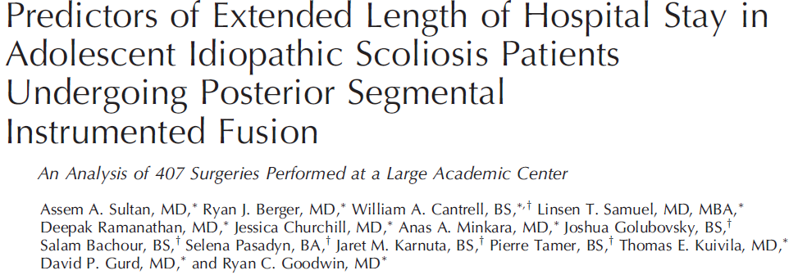
Background
Many recent studies have evaluated patient factors influencing hospital length-of-stay (LOS) following posterior spinal instrumentation and fusion (PSIF)
Studies have been a mix of single-centre and national databases analyses
All studies have been conducted in the United States and it is unknown if these factors are similar to those in Canada

Slide 4
Objectives
To determine if the pre- and peri-operative patient and demographic factors that have shown to prolong hospital LOS in the United States are similar to the factors that prolong hospital LOS in Canada for scoliosis patients undergoing PSIF

Slide 5
Previous Studies
Previous Study | Description of Cohort | Pre-Operative Factors | Intra-Operative Factors | Post-Operative Factors
Yoshihara et al., 2018 | Nationwide database of 23,279 patients | Elixhauser Comorbidity Index Teaching Hospital | Number of levels fused ≥9 | In-hospital complication Nonroutine disposition
Martin et al., 2020 | Single centre analysis of 169 patients | Patient ethnicity Female sex | Longer procedure time Increased number of levels fused Higher volume of crystalloid administered | Higher post-operative day 1 pain scores Higher cumulative morphine use
Harris et al., 2020 | Nationwide database of 5864 patients | Female gender Surgery performed on Wednesday | Number of levels fused ≥13 Thoracoplasty | Post-operative complication ICU admission
Elsamadicy et al., 2019 | Nationwide database of 3759 patients | Increased comorbidities Female sex Obesity | Receiving a blood transfusion Number of levels fused ≥9 Intra-operative complication
Sultan et al., 2018 | Single centre analysis of 407 patients | Female sex Greater thoracic kyphosis | Number of levels fused ≥9 Greater blood loss Lack of epidural analgesia | - Post-operative complication

Slide 6
Methods
Retrospective review of 161 patients that underwent surgery between March 2015 and August 2020
Average hospital LOS was 3.6±0.70 days for the RRP cohort
Features Selected
Sex
BMI
Procedure time
Levels fused
Intra-operative blood loss
Receiving a blood transfusion
Epidural analgesia
Average pain score on post-operative day (POD) 1
Morphine equivalent use POD1
Spearmen rank order correlations were used to determine the pre- and peri-operative features most associated with LOS

Slide 7
Correlations
 | Mean (SD) | Spearman rho | P-value
PRE-OPERATIVE
Sex | 77% female | -0.14 | 0.087
BMI (kg/m²) | 21.0 (±4.2) | -0.052 | 0.52
INTRA-OPERATIVE
Procedure time (hrs) | 5.84 (±1.2) | -0.074 | 0.35
Levels Fused | 10.8 (±1.9) | 0.11 | 0.15
Intra-operative blood loss (mL) | 811 (±413) | 0.034 | 0.69
Transfusion | 8.1% received transfusion | 0.24 | 0.002*
Epidural analgesia (mcg) | 297 (±184) | -0.12 | 0.17
POST-OPERATIVE
Pain Score post-operative day 1 | 3.0 (±1.8) | -0.14 | 0.86
Morphine equivalents POD 1 (mg/kg) | 1.47 (±0.81) | 0.08 | 0.32

Slide 8
Conclusion
Using factors found to be significant in the United States, only receiving a peri-operative transfusion was associated with prolonged hospital LOS in Canada
Clinicians should use their judgement when using results from the United States to predict if a patient will have a prolonged hospital LOS in Canada
Future studies should characterize the factors in Canada associated with prolonged hospital LOS for adolescent scoliosis patients

