Slide 1
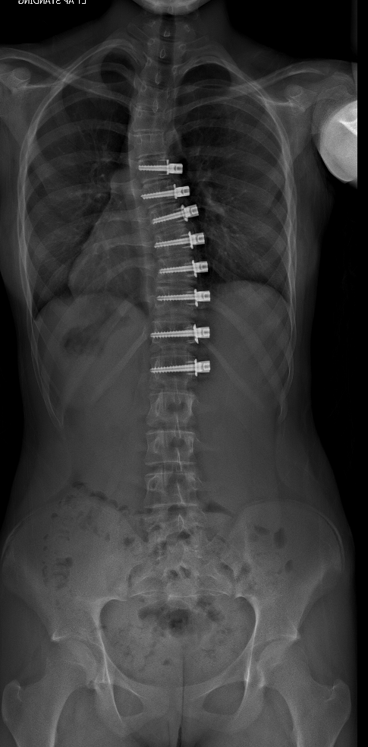
Is Vertebral Body Tethering Minimally Invasive ? A Comparison of Early Post-Operative Outcomes to Posterior Spinal Instrumentation and Fusion
Zachary DeVries, James Jarvis, Andrew Tice and Kevin Smit

Slide 2
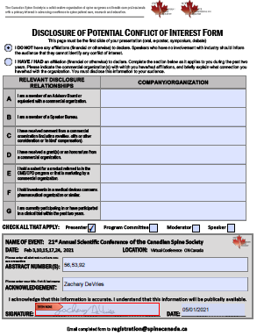
DISCLOSURE

Slide 3
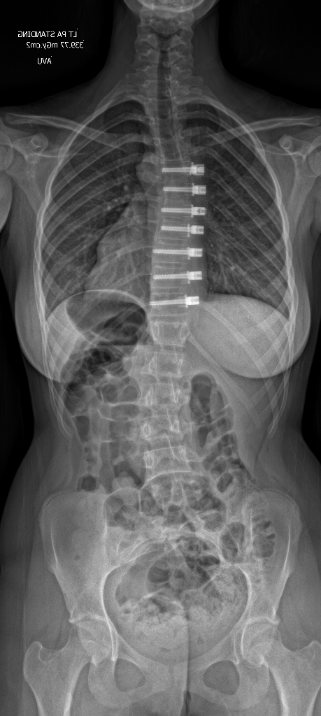
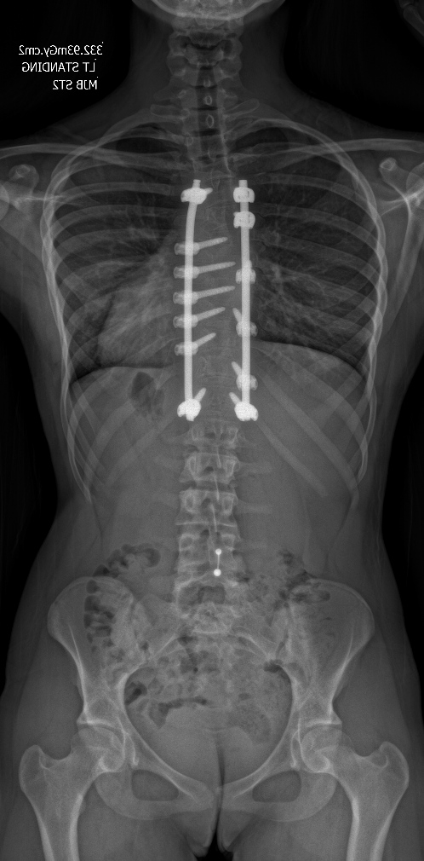
BACKGROUND
VBT is a novel surgical technique that utilizes the remaining growth potential in scoliosis patients to correct their spinal deformity
Compared to PSIF it is reported as being
Less invasive
Motion sparing
Improved recovery time
No analysis has yet compared the immediate post-operative recovery of vertebral body tethering to that with posterior spinal instrumentation and fusion

Slide 4
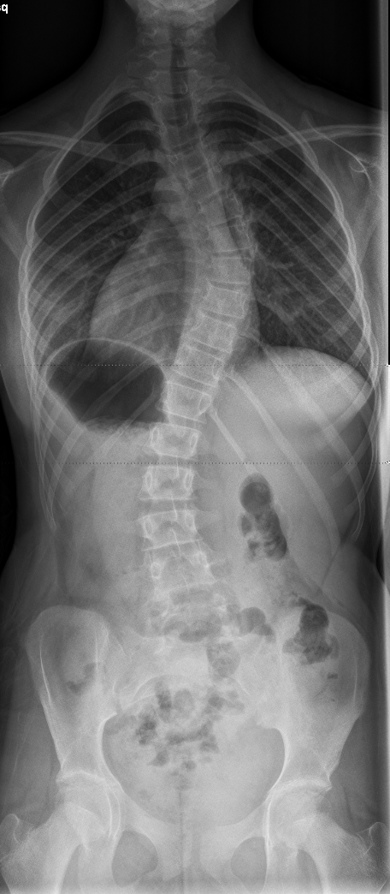
OBJECTIVES
To compare the early post-operative period for adolescent idiopathic scoliosis patients undergoing vertebral body tethering (VBT) to posterior spinal instrumentation and fusion (PSIF)
VBT
PSIF

Slide 5
METHODS
Retrospective review of 22 VBT patients and 21 age- and curve-matched PSIF patients that underwent surgery between March 2015 and August 2020
Features Extracted
Demographic information
Pre- and post-operative Cobb angle
Length-of-stay
Post-operative complications
Exclusion Criteria
Previous spinal surgery
Neuromuscular or congenital scoliosis
Statistical Analysis
Student t-tests and chi square analysis
Significance set at p<0.05

Slide 6
RESULTS
INTRA-OPERATIVE | PSIF (n=21) | VBT (n=22) | p-value
Levels Instrumented (mean) | 9.6 ± 0.87 | 7.8 ± 0.61 | <0.001*
Curve Correction (º) | 43.5⁰ ± 7.7 | 24.4⁰ ± 7.8 | <0.001*
EBL (mL) | 704 ± 300 | 350 ± 172 | <0.001*
OR time (hrs) | 5.3 ± 1.0 | 4.0 ± 0.72 | <0.001*
PRE-OPERATIVE | PSIF (n=21) | VBT (n=22) | p-value
Age (mean) | 14.0 ± 0.73 | 12.5 ± 1.4 | <0.001*
Sex (% female) | 85.7 | 95.5 | >0.05
Menarchal Status (% post-menarchal) | 66.7% | 25.0% | 0.015*
BMI (kg/m²) | 22.8 ± 5.0 | 20.2 ± 4.6 | 0.087
Bracing Initiated (% total) | 33.3% | 59.1% | >0.05
Curve Magnitude (mean) | 60.2⁰ ± 6.1 | 55.8 ±6.2 | 0.025*
POST-OPERATIVE | PSIF (n=21) | VBT (n=22) | p-value
Foley Discontinued (% after POD1) | 95.2% | 72.7% | 0.037*
Day Standing Initiated (% after POD0) | 100% | 77.3% | 0.02*
Day Walking Initiated (% after POD1)) | 95.2% | 22.7% | <0.001*
Hours to PCA Discontinuation (h) | 52.3 ± 2.7 | 50.4 ± 13.1 | 0.52
Hospital LOS (d) | 3.5 ± 0.44 | 3.1 ± 0.46 | 0.002*
30-day Complication | 1 | 1 | 0.973

Slide 7
RESULTS
*
*
Figure 1. Morphine use post-operative in PSIF and VBT patients
Figure 2. PCA Morphine use post-operative in PSIF and VBT patients
Figure 3. Ondansetron use post-operative in PSIF and VBT patients

Slide 8
RESULTS – TAKE HOME
 | Age (y) | Curve (º) | OR Time (hr) | EBL (mL) | Standing day 0 | Walking day 1 | Pain PO#2 (VAS) | PO#2 opioid (mg) | PCA PO#1 (mg) | LOS (d)
PSF (21) | 14.0 ± 0.7 | 60.2 ± 6.1 | 5.3 ± 1.0 | 704 ± 300 | 0 | 5% | 3.4±1.7 | 58.3 ± 30.7 | 69.3 ± 48.5 | 3.5 ± 0.44
VBT (22) | 12.5 ± 1.4 | 55.8 ± 6.2 | 4.0 ± 0.72 | 350 ± 172 | 23% | 77% | 2.2±1.4 | 33.7 ± 25.9 | 37.0 ± 32.5 | 3.1 ± 0.46
P-value | <0.05 | <0.05 | <0.05 | <0.05 | <0.05 | <0.05 | <0.05 | <0.05 | <0.05 | <0.05
VBT TAKE HOME: Younger, ↓ curve size, ↓ OR time, ↓ Blood Loss, ↑ Mobility, ↓ Pain, ↓ LOS

Slide 9
CONCLUSION
Compared to PSIF, VBT can be considered less invasive
VBT patients had shorter operating times with less blood loss
VBT patients were able to mobilize sooner post-operatively and were discharged from hospital earlier than PSIF patients
VBT patients required less narcotics for pain control compared to PSIF
Limitations include difficulties with age and curve-matching the cohorts

