Slide 1
Learning curves in spine surgery: Evaluating the first two years of independent practice Canadian Spine Society: 21st Annual Scientific Conference
Ferguson, Devin MD; Stevens, Madison MD, MSc; Dunning, Cynthia PhD; Oxner, William MD, FRCSC, Glennie, R Andrew MD, MSc, FRCSC

Slide 2
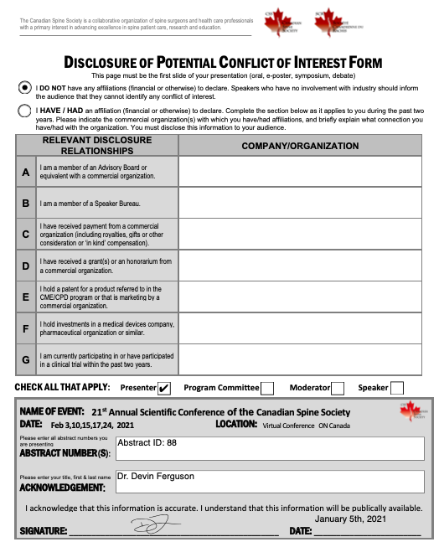

Slide 3
Background
Quantifying the spine surgical learning curve is challenging
Surrogates for surgical proficiency include:
Operative time
Intra-operative blood loss
Complications

Slide 4
Background
ONLY publication analyzing surgical learning curve of a novice surgeon starting independent practice

Slide 5
Objectives
Evaluate the surgical learning curve of a novice spine surgeon
Use a senior spine surgeon as a comparator
Examine the relationship between surgical experience and overall operative time for common elective spine surgeries
Assess frequency of reoperation, CSF leak, and revision surgery

Slide 6
Methods
Data source: Local spine surgical registry (2014 – 2016)
Divided into six-month quarters
Inclusion criteria: ACDF, Posterior C-spine, Single-level TLIF, Two-level TLIF, Discectomy, and Laminectomy
Primary outcome: Operative time
Secondary outcome: CSF leak, reoperation, revision
Comparative group: Senior surgeon Quarter 1 operative time
Data analysis: Multiple regression model, marginal plots obtained from interaction models, chi-squared analysis
Sub-group analysis: Single level TLIF and Laminectomy

Slide 7
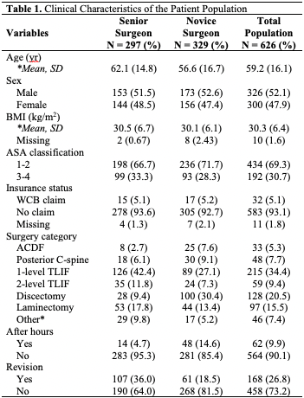
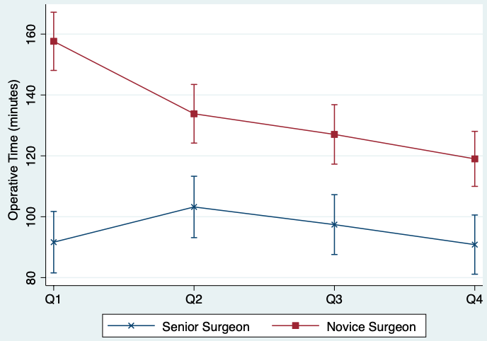
Results
Novice surgeon operative time decreased from 157.6 to 119 min
Senior surgeon reference = 91.6 min

Slide 8
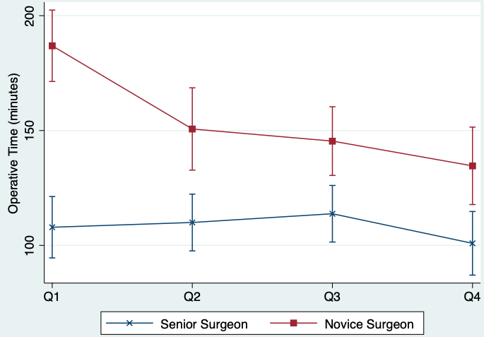
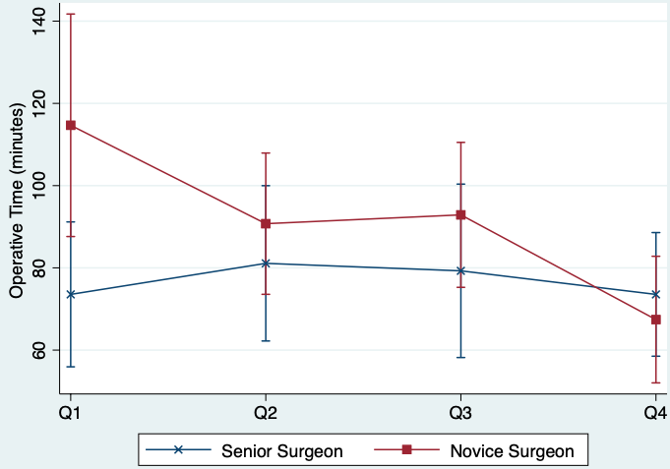
Results
Novice surgeon one-level TLIF operative time decreased from 186.9 to 134.6 min
Senior surgeon reference = 107.9 min
Novice surgeon laminectomy operative time decreased from 114.7 to 67.4 min
Senior surgeon reference = 73.6 min

Slide 9
Secondary Outcomes
No significant difference in rates of CSF leak between surgeons
OR 1.2 [95% CI 0.6 – 2.5]; P > 0.05
No significant difference in rate of reoperation between surgeons
OR 1.16 [95% CI 0.7 – 1.9]; P > 0.05
Senior surgeon was more likely to perform revision surgery
OR 2.5 [95% CI 1.7 -3.6]; P < 0.001

Slide 10
Conclusion
Novice spine surgeons may accelerate through the learning curve for less technically demanding operations
Laminectomy vs. Single level TLIF
Despite the learning curve, novice spine surgeons are safe
There is likely further technical skill refinement that occurs after 2 years of independent practice

