Slide 1
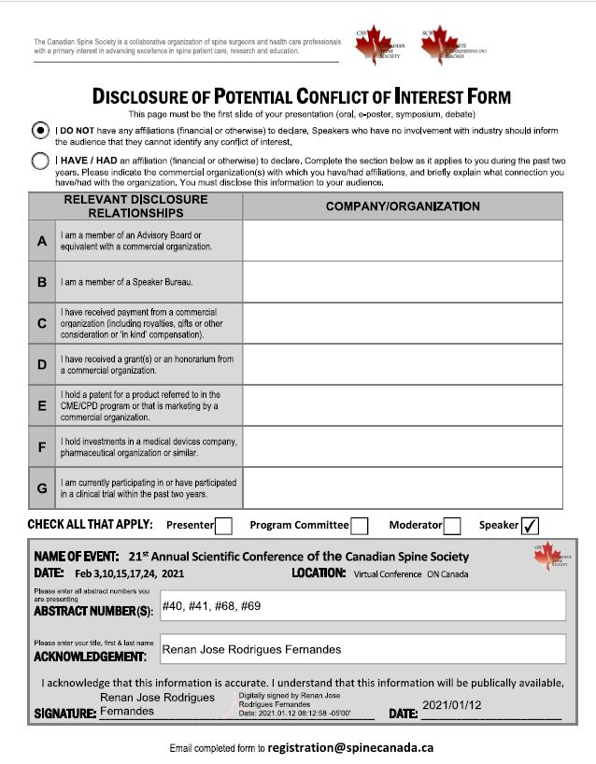

Slide 2
Biomechanical evaluation of a C1-C2 posterior arch screw construct
Renan Fernandes^{1,2}, Aaron Gee^{1,3} , Nicole Schneider^{1,2}, Andrew Kanawati^{1,2,4}, Emil Schemitsch^{1,2}, Chris Bailey^{1,2}, Parham Rasoulinejad^{1,2} , Radovan Zdero^{1,2,3}
1. London Health Sciences Centre, London, ON, Canada; 2. Western University, London, ON, Canada, 3. Lawson Health Research Institute, London, ON, Canada 4. Westmead Hospital, Sydney, NSW, Australia

Slide 3
Biomechanical evaluation of a C1-C2 posterior arch screw construct
Introduction
The use of posterior arch screws in addressing atlantoaxial stability has the potential to decrease dissection, blood loss, and neurovascular injury compared to the current gold standard Harms procedure.
The purpose of this study was to evaluate and compare the biomechanics of a C1-C2 posterior arch screw construct against the Harms procedure for posterior atlantoaxial fixation on a human cadaveric model.

Slide 4
Biomechanical evaluation of a C1-C2 posterior arch screw construct
Methodology
Nine fresh frozen human cadaveric cervical specimens from occiput to C3 (8 male; mean age: 66.6) were used for testing range of motion (ROM).
Each specimen was tested for four configurations:
Intact
Destabilized
C1-C2 posterior arch screw (PAS) construct
Harms construct

Slide 5
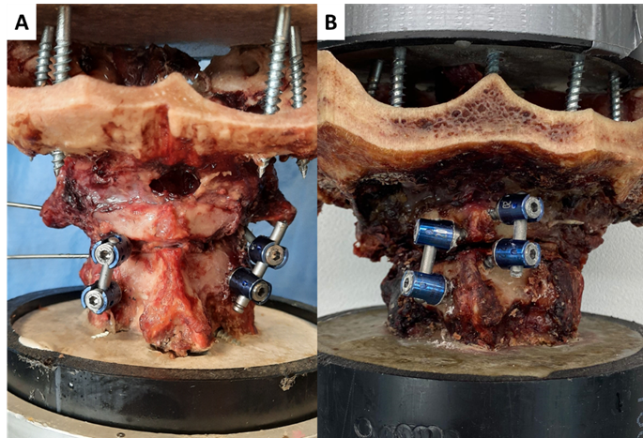
Biomechanical evaluation of a C1-C2 posterior arch screw construct
Methodology
The destabilized configuration was created with an osteotomy of the odontoid base to simulate a type II fracture.
After testing the destabilized configuration spines were repaired with both the Harms technique (Figure 1A) and the C1 posterior arch and C2 bilateral laminar construct (Figure 1B).
The order in which repair method was performed and tested first was randomized
Figure 1: (A) Harms surgical construct and (B) Posterior arch screw construct

Slide 6
Biomechanical evaluation of a C1-C2 posterior arch screw construct
Methodology
A pure moment of 1.5Nm was applied for each test.
The ROM of the C1-C2 segment was measured in flexion-extension, lateral bending and axial rotation.
Motion was captured using ARAMIS (Trilion, King of Prussia PA, USA) a digital image correlation system capable of measuring 3D motion.
Figure 2: Spine testing apparatus and motion capture system

Slide 7
Biomechanical evaluation of a C1-C2 posterior arch screw construct
Results
Table 1: Range of motion at 1.5 Nm for each of the motion modes in the intact condition, destabilized condition, repaired with Harms and repaired with posterior arch screws.
Group | Flex/Ext | Lateral Bending | Axial Rotation
Intact | 5.08±2.23‡ | 1.55±1.04‡ | 38.11±16.19
Destabilized | 12.17±3.27† | 9.33±5.06† | 47.50±11.49
Harms Technique | 1.72±1.17‡ | 2.02±0.91‡ | 1.84±1.08†‡
Posterior Arch Screws | 2.27±2.16‡ | 3.95±1.82‡ | 2.48±1.21†‡
Values are presented as mean ± standard deviation.
†Significantly different from intact
‡Significantly different from destabilized

Slide 8
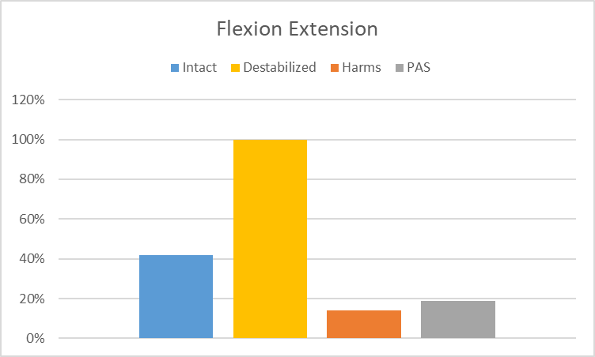
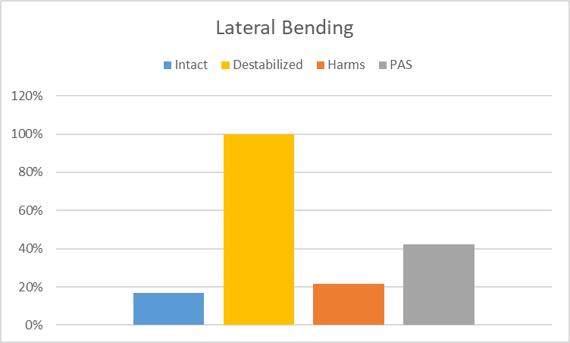
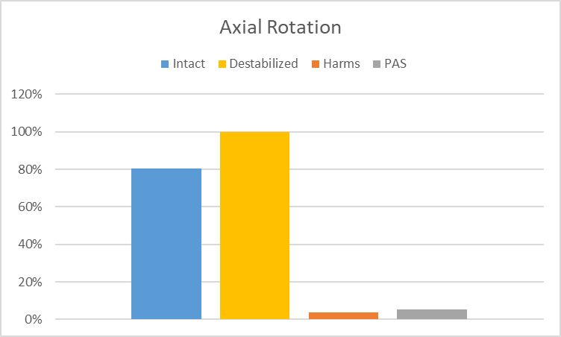
Biomechanical evaluation of a C1-C2 posterior arch screw construct
Results
Figure 3: Range of motion graphs for flexion-extension, lateral bending, and axial rotation (from left to right). Range of motion was normalized by the destabilized condition

Slide 9
Biomechanical evaluation of a C1-C2 posterior arch screw construct
Results
Results were normalized to the ROM in the destabilized condition.
Harms and PAS groups significantly increase stability when compared with the destabilized condition for flexion-extension, lateral bending, and axial rotation (p<0.003).
There was no significant difference in stability when comparing Harms with PAS in flexion-extension (p = 0.964), lateral bending (p = 0.513), or axial rotation (p = 0.999).

Slide 10
Biomechanical evaluation of a C1-C2 posterior arch screw construct
Conclusion
The study demonstrates that a C1-C2 PAS construct can restore or increase biomechanical stability compared to the intact condition.
C1-C2 PAS offers similar biomechanical stability as the Harms construct.
C1-C2 PAS may be utilized as a salvage method or a less invasive alternative to C1 lateral mass screws and C2 pedicle screws during atlantoaxial fixation.

