Slide 1
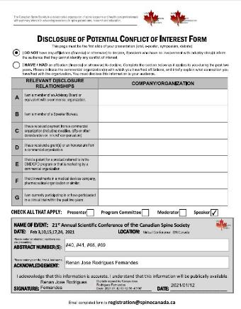

Slide 2
Accuracy of patient-specific drill guides for C1 and C2 laminar screw placement
Renan Fernandes^{1,2}, Nicole Schneider^{1,2}, Aaron Gee^{1,3}, Andrew Kanawati^{1,2,4}, Radovan Zdero^{1,2,3}, Chris Bailey^{1,2}, Parham Rasoulinejad^{1,2}
1. London Health Sciences Centre, London, ON, Canada; 2. Western University, London, ON, Canada, 3. Lawson Health Research Institute, London, ON, Canada 4. Westmead Hospital, Sydney, NSW, Australia

Slide 3
Accuracy of patient-specific drill guides for C1 and C2 laminar screw placement
Introduction
Additive manufacturing in Orthopaedic surgery continues to grow allowing for more accurate placement of implants and reduced surgical time.
The use of laminar screws in addressing atlantoaxial stability has the potential to decrease dissection, blood loss, and neurovascular injury compared to the current gold standard Harms procedure.
Limited space within the lamina for crossing screws necessitates accurate placement.
PURPOSE: to evaluate the accuracy of using patient-specific drill guides to place bilateral laminar screws in C1 and C2.

Slide 4
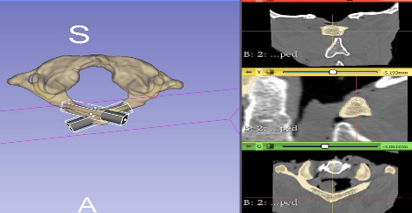
Accuracy of patient-specific drill guides for C1 and C2 laminar screw placement
Methodology
Nine fresh Occipital-cervical (C0-C3) specimens (8 male; mean age: 66.6)
Pre-insertion CT-scans were performed to create digital models of the anatomy for templating and guide creation.
Figure 1: Pre-operative CT scan and segmentation C1 vertebra

Slide 5
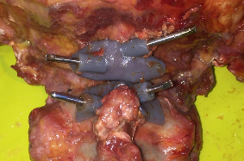
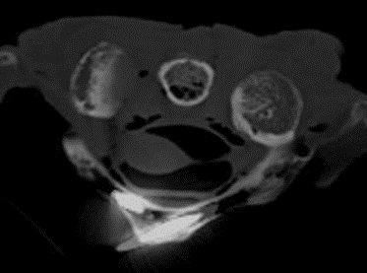
Accuracy of patient-specific drill guides for C1 and C2 laminar screw placement
Methodology
A total of 36 screws were placed with the aid of 3D printed patient specific guides (bilateral laminar screws at C1 and C2).
Post-insertion CT-scans were performed.
Figure 2: C1 & C2 Guides placed with K-wires attached
Figure 3: Post operative CT scan C1 vertebra

Slide 6
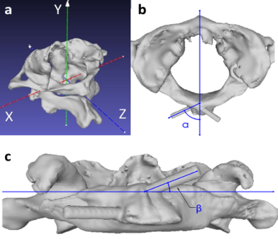
Accuracy of patient-specific drill guides for C1 and C2 laminar screw placement
Methodology
The planned and actual trajectory was compared using pre and post-insertion imaging based on the angular and entry point deviation.
Following post-insertion imaging specimens were dissected and a visual inspection for breaches was performed.
Figure 4: Comparison of planned vs actual trajectories

Slide 7
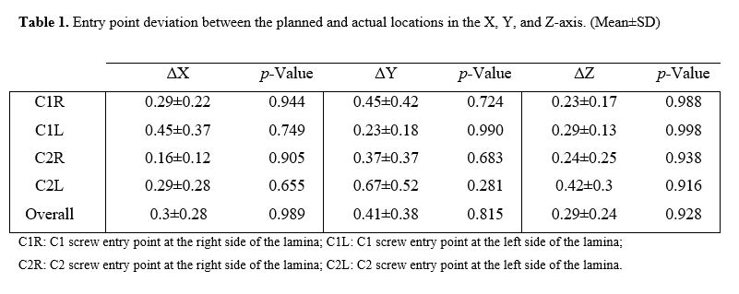
Accuracy of patient-specific drill guides for C1 and C2 laminar screw placement
Results: Entry Point Difference

Slide 8
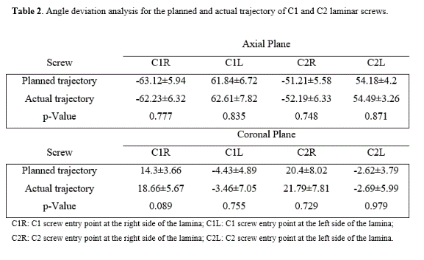
Accuracy of patient-specific drill guides for C1 and C2 laminar screw placement
Results: Trajectory Difference

Slide 9
Accuracy of patient-specific drill guides for C1 and C2 laminar screw placement
Results: Cortical Breaches
Visual inspection: No cortical breach was seen in the screw pathway in C1 or C2 laminas.
Figure 5: Visual inspection of C1 vertebra

Slide 10
Accuracy of patient-specific drill guides for C1 and C2 laminar screw placement
Conclusion
The study demonstrates that patient-specific drill guides allow for accurate C1 and C2 bilateral laminar screw placement, with a low risk of cortical breach.

