Slide 1
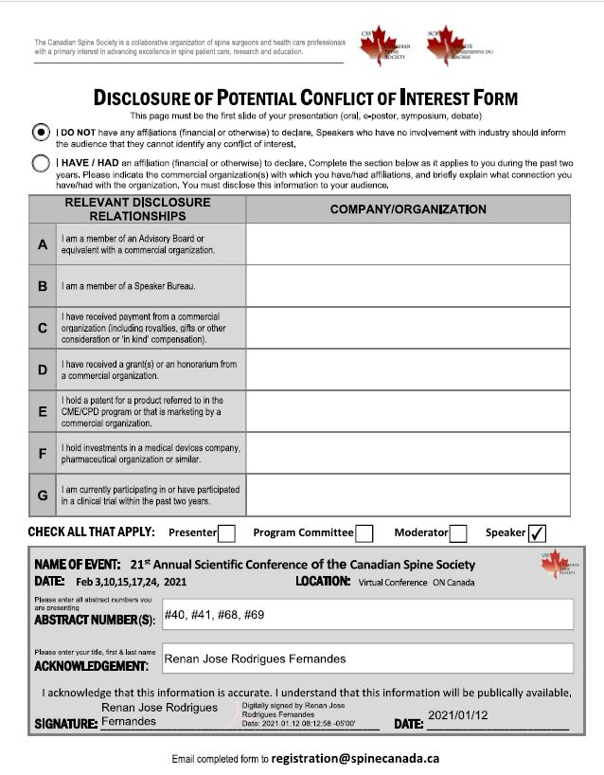

Slide 2
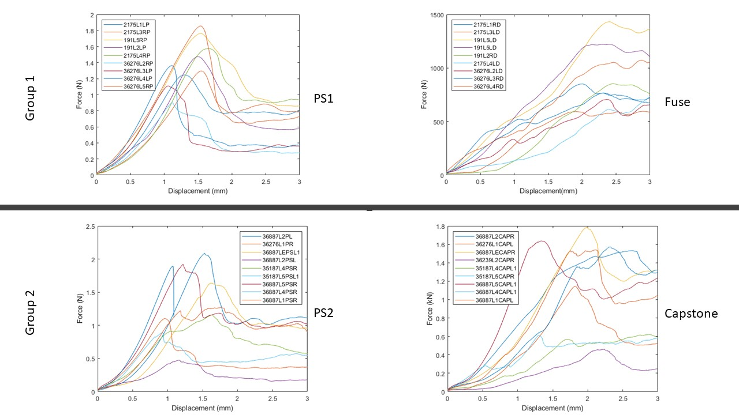
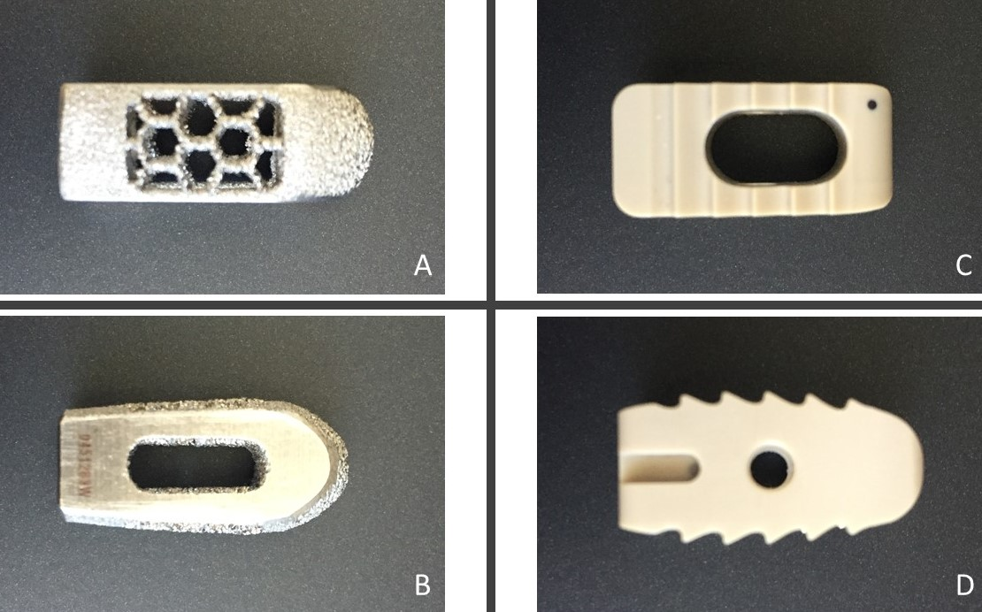
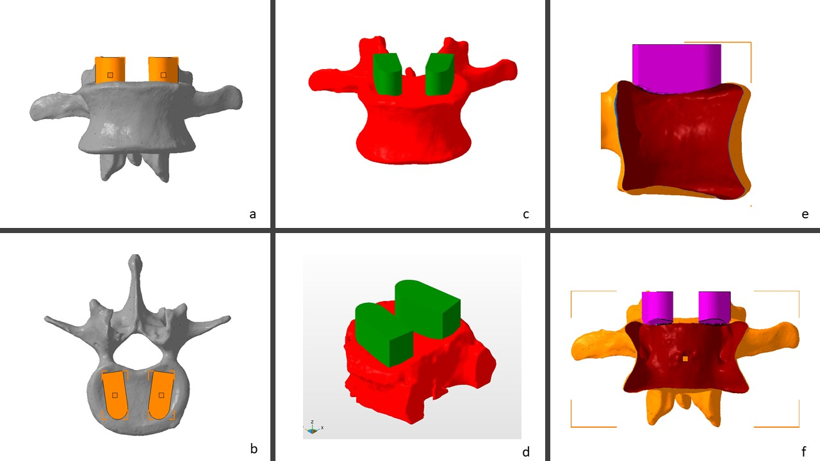
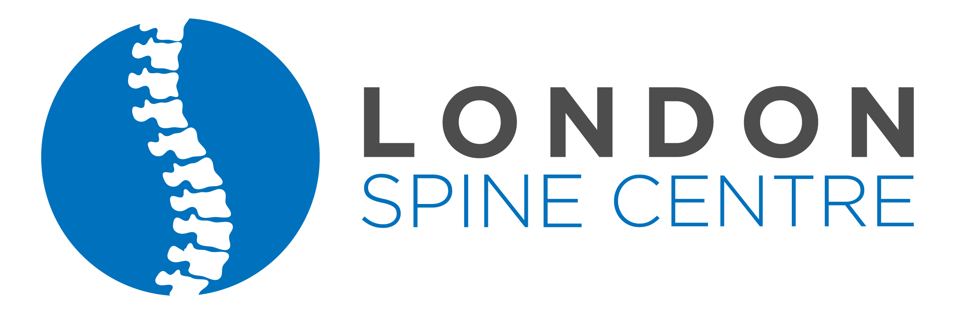
Biomechanical comparison of subsidence between patient-specific and non-patient-specific PLIF cages Renan J R Fernandes¹, Aaron Gee¹, Andrew J Kanawati¹,², Parham Rasoulinejad¹, Radovan Zdero¹,³, Chris S. Bailey¹ ¹Western University, London Health Research Institute, LHSC – London, ON, Canada; ²Westmead Hospital – Sydney, NSW, Australia; ³ Department of Mechanical Engineering, Western University – London, ON, Canada
Introduction
PLIF surgery is one of the most popular interbody fusion techniques among spine surgeons
Subsidence remains one of the biggest complications after LIF
Biomechanical studies comparing cage shapes and sizes have found significant differences when increasing the surface of contact with larger cages.
None of them specifically focused on the effect of a patient-specific intervertebral disc device.
PURPOSE
Compare the stiffness and loading distribution parameters using PLIF implants that match the endplate bone geometry compared to flat surface commercial PLIF cages.
Methods
CT scan images of the lumbar spine of cadaveric specimens were obtained.
3D volumetric reconstruction sequence was performed to obtain a 3D model from the vertebrae
PLIF cages matching the endplate geometry were obtained through a Boolean operation and 3D printed using a resin with properties similar to PEEK
Biomechanical testing was performed on the cadaveric lumbar vertebrae comparing the patient-specific (PS) cages to two commercially available cages (Fuse and Capstone)
Statistical analysis
Paired t-tests were used to compare the peak failure force and stiffness between the groups.
Results
Patient-specific x Fuse cage (Group 1)
Mean force to failure was 1399N for PS1 cage and 852N for Fuse cage(p<0.001)
Mean stiffness was 1274N/mm and 431N/mm(p<0.001)
Patient-specific x Capstone cage (Group 2)
Mean force to failure was 1381N for PS2 cage and 1164N for Capstone cage(p=0.086)
Mean stiffness was 1382N/mm and 867N/mm(p=0.009)
Table 1. Summary of results
Conclusion
Interbody fusion implants matching the endplate surface can help prevent subsidence since they require a higher force to subside.
Patient-specific cages presented a significantly higher stiffness than the commercially available cages shapes used for this study.
Figure 3. Force-displacement plot for every group. Top: group 1 – PS cage on the left and Fuse cage on the right. Bottom: group 2 – PS cage on the left and Capstone cage on the right.
Figure 1. Commercial cages used during biomechanical testing to compare with
patient-specific cage. A and B: Fuse cage; C and D: Capstone cage
Figure 2. Anterior and superior views of cage planned positions(a-b), anterior and oblique views of the Boolean operation(c-d), and lateral and anterior views of the hollow vertebra and the conformational implant post-Boolean operation(e-f).

