Slide 1
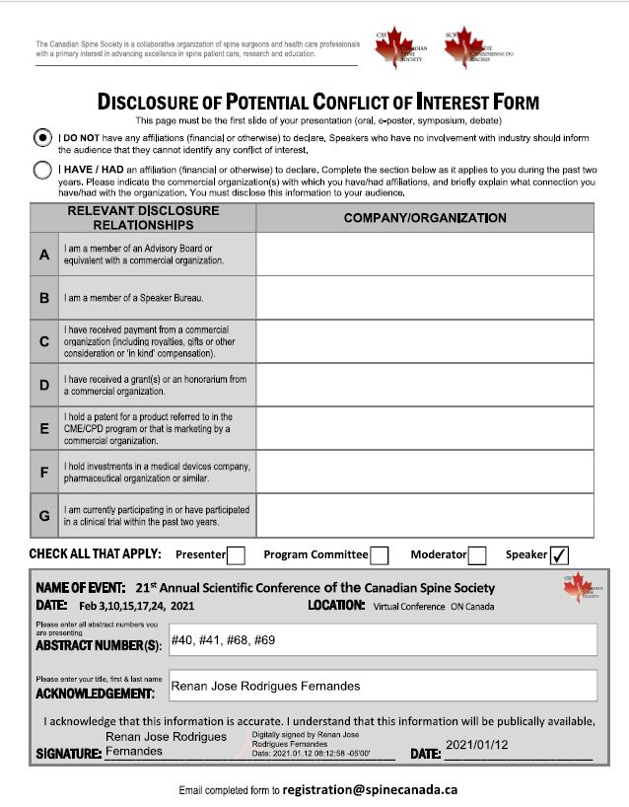

Slide 2
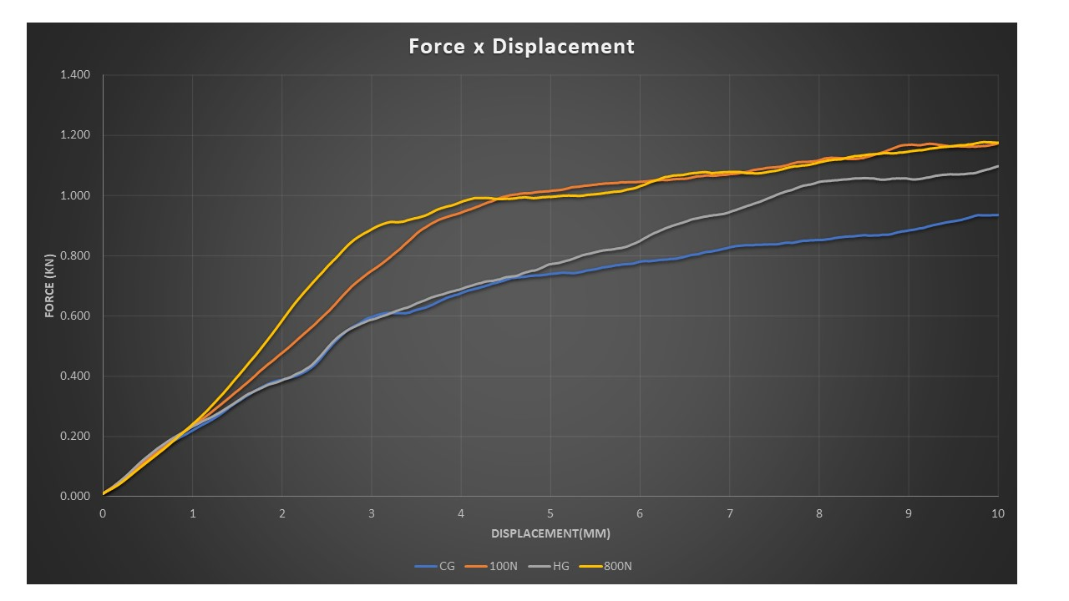
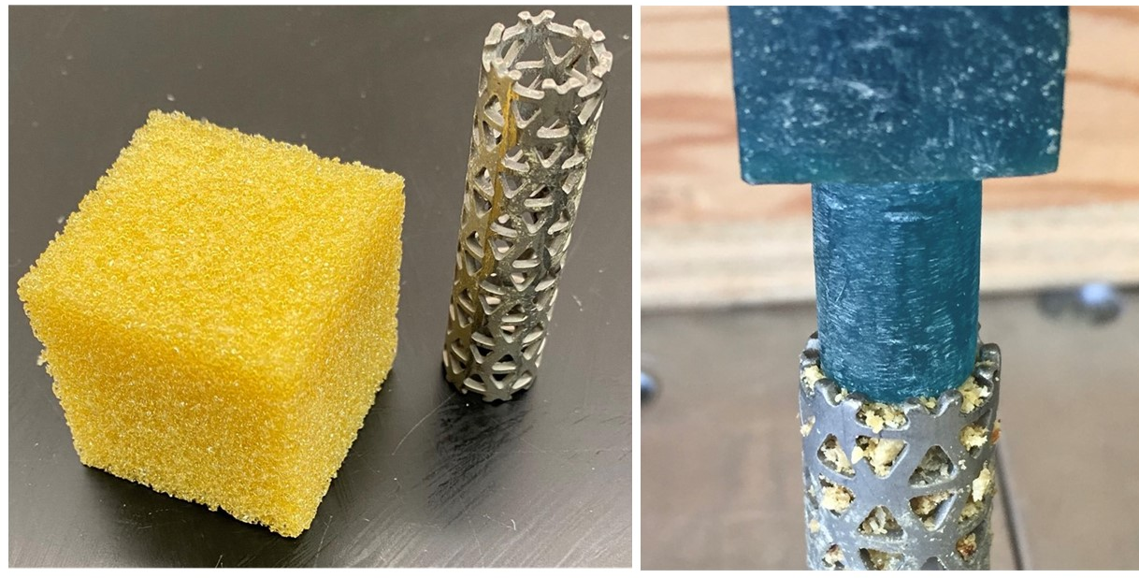
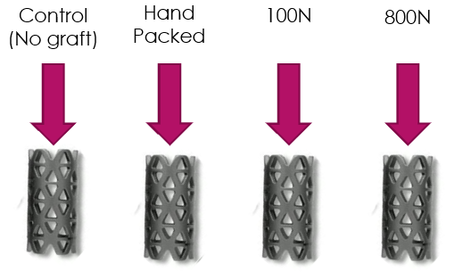
Does the impaction of morselized bone graft prevent interbody fusion device subsidence? Renan J R Fernandes¹, Aaron Gee¹, Andrew J Kanawati¹,², Parham Rasoulinejad¹, Radovan Zdero¹,³, Chris S. Bailey¹ ¹Western University, London Health Research Institute, LHSC – London, ON, Canada; ²Westmead Hospital – Sydney, NSW, Australia; ³ Department of Mechanical Engineering, Western University – London, ON, Canada
Introduction
Cages are a common medical device used for interbody fusion surgery
Subsidence remains one of the biggest complications
Several strategies have been employed to attenuate the risk of subsidence
Although most cages present an open space to house morselized bone graft to increase fusion rates, there is no published study so far exploring the contribution of the graft to prevent subsidence.
PURPOSE
Investigate the role of the hand-packed graft in the prevention of subsidence
Determine if the morselized bone graft can be compressed to the point that provides mechanical support to minimize cage subsidence
Methods
A titanium mesh cage was compressed over polyurethane foam blocks.
Four constructs were used to compare the role of the bone graft in the prevention of subsidence
I. First group had no graft and served as the control group (CG)
II. Second group, the graft was hand packed (HG)
III. Third group, the graft was packed to 100 newtons (PG1)
IV. Fourth group, the graft was packed to 800 newtons (PG2)
Statistical analysis
Comparisons between the peak force required for a 3mm subsidence and stiffness were made using the Kruskal-Wallis test. When needed, the post-hoc Mann-Whitney U test was used to compare the possible combinations.
Results
For clinically relevant subsidence(3mm), the average force was 597N in the CG, 588N in HG, 751N in PG1 and 888N in PG2.
Post-hoc analysis showed a statistically significant difference among all the constructs except between CG and LG.
Mean stiffness was 0.182N/mm for the CG, 0.181N/mm for HG, 0.241N/mm for PG1, and 0.314N/mm for PG2.
There was no difference in stiffness between CG and LG, but it was statistically significant between the other constructs(p<0.001).
Table 1. Summary of results
Conclusion
Compression of the bone graft by hand does not help in the prevention of subsidence
The impaction of the graft to greater forces can play an essential role in the prevention of subsidence.
Compressing the bone graft leads the bone graft elastic modulus to get closer to the cortical bone elastic modulus. Thereby, it causes the stress to redistribute from the implant to the graft site, leading to better transmission of load through the construct.
Figure 1. Left side: Titanium mesh cage and polyurethane foam block used for testing. Right side: Bone graft being compressed inside the cage.
Figure 2. Drawing showing testing groups
Figure 3. Mean force-displacement plot for the testing groups.

