Slide 1
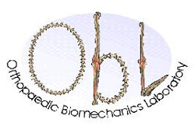
Canadian Spine Society: 21st Annual Scientific Conference
Quantitative Imaging Derived Metrics of Sarcopenia Applied to Prostate Cancer
Preliminary Study
Kelly Fullerton, Geoff Klein, Urban Emmenegger, Joel Finkelstein, Frank Lyons, Cari Whyne, Michael Hardisty
2/1/21

Slide 2
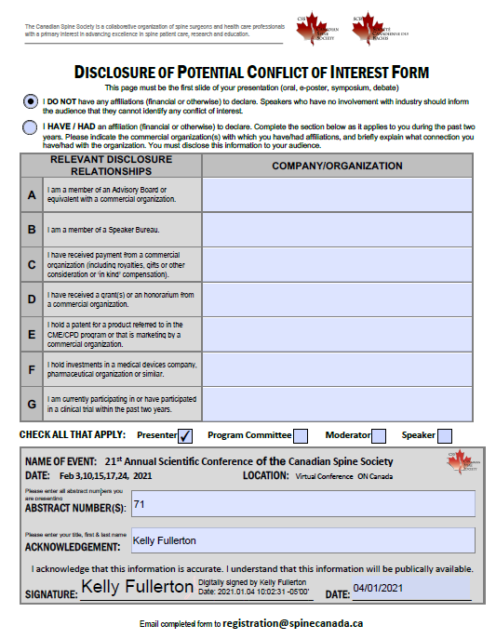
Notes:
I have no disclosures to report on this research.

Slide 3
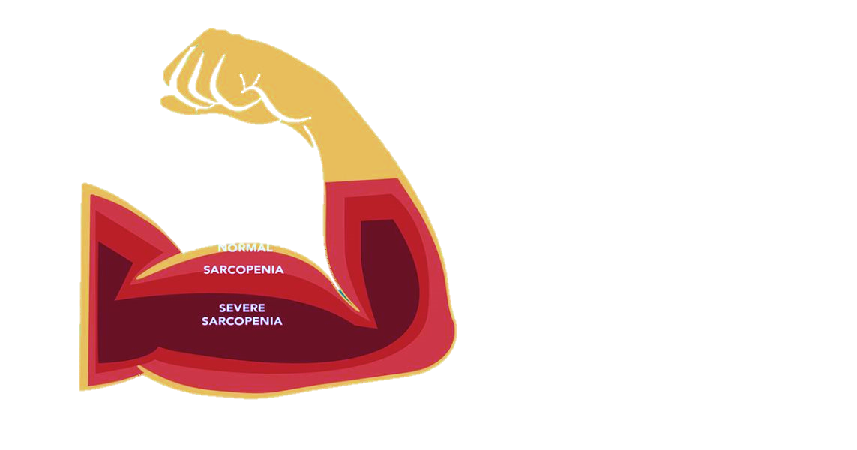
The Problem:
Sarcopenia- Quantifying Small Changes
11-74%
Cancer Patients
Affected
SARCOPENIA IS
MUSCLE LOSS OVER TIME
20%
Cancer Deaths
2D Methods Slow + Struggle to Measure Small Changes
Difficult to preemptively treat!
Notes:
Sarcopenia (or muscle loss) has long been a clinical problem that is difficult to accurately quantify. Sarcopenia is strongly correlated to surgical complications and mortality. It is a large issue in the elderly and in cancer patients, and is a common complication in prostate cancer. Because metastasis to the spine is common in cancer patients as well (especially prostate cancer patients), this only increases the clinical impact of sarcopenia in this population.
Current methods for quantifying sarcopenia typically involve manual segmentation of the muscle area on a single CT scan slice. Even this 2D analysis can be time consuming and prone to errors in identifying small muscle changes. Such manual methods are also unscalable for large scale clinical trials or routine clinical use. Without accurate quantification of sarcopenia, it is difficult know when to initiate interventions or understand the impact of differing cancer treatment on its progression.

Slide 4
Objective:
Objectives 3D Quantification of Sarcopenia:
Fast
Accurate
Reliable
Design: Retrospective study using routine CTs
Notes:
The objective of this study was therefore was to produce a reliable solution to measure sarcopenia quickly and accurately. Sensitive 3D quantification of sarcopenia will enable future study of treatment effects and improvement of prostate cancer care. This study used a retrospective design to investigate the potential of deep learning, specifically training a convolutional neural network, for 3D volume segmentation of the psoas muscle to be used as an indicator of sarcopenia.

Slide 5
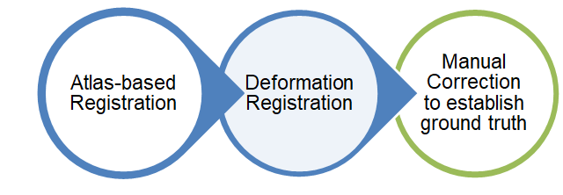
Methods:
Routine surveillance and staging CT imaging for prostate cancer patients (UE:abdo-pelvic CTs)
Volumes included psoas muscle of:
26 unique patients (initial & subsequent scans)
Training: 26 volumes/21 unique patients
Validation: 6 volumes/5 unique patients
Psoas muscle measured on initial + follow up imaging
Segmentation masks created during an initial study between the L2/L3 & L4/L5 intervertebral disks:
Notes:
The psoas muscle was segmented between the L2/3 and L4/L5 intervertebral disks in routine spine CTs for prostate cancer patients. Measuring a volume instead of surface area was chosen to get a more accurate picture of muscle loss and lead to a more robust, fast and reliable method of quantifying sarcopenia. 26 unique patients were used for this study with their initial and follow-up scans. Segmentations were created from an initial study using atlas based fiduciary registration, deformation registration and then touched up with manual corrections to establish a ground truth.

Slide 6
Methods:
Image preprocessing for deep learning
Volumes:
Cropped to ROI
Resampled to voxel sizes of 1.15x1.15x2.50mm³
Padded to 128 x 128 x 64 voxels
Intensities normalized
Notes:
The images were cropped to the region of interest, resampled and padded with their intensities normalized in order to be able to be trained with the CNN efficiently.

Slide 7
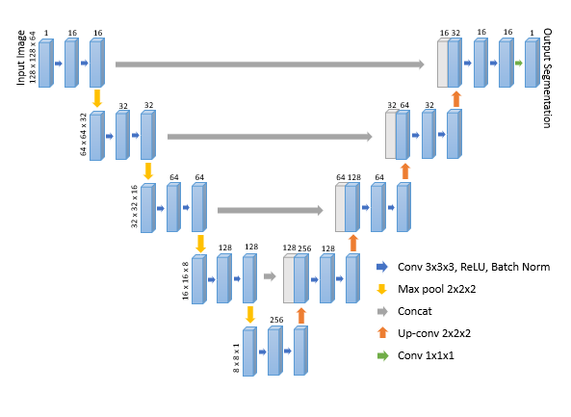
Methods:
Machine Learning with CNNs for Volume Segmentation
U-Net CNN architecture
Batch normalization + intensity augmentation added for improved training
A binary cross-entropy loss function was used to optimize the backpropagation of weights
Training: 300 epochs in batches of 6.
Notes:
A U-Net Convolutional Neural Network was used for the model’s architecture. Batch normalization and intensity augmentation were added for improved training. A binary cross-entropy loss function was used to optimize the back propagation of weights. Training was done in 300 epochs in batches of 6. Then the predicted masks were evaluated using their dice similarity coefficient (DSC) for accuracy.

Slide 8
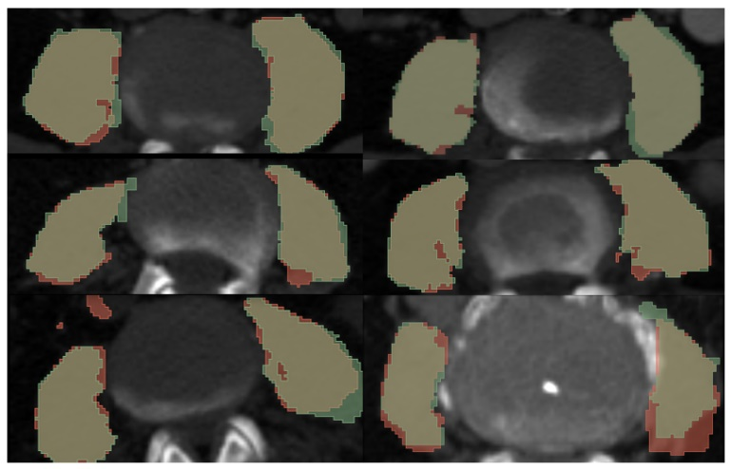
Results:
89% Accuracy
0.175s to segment
*average using Nvidia Titan RTX GPU and Intel 9900X CPU
Figure 2: Overlay of segmentation masks onto an axial slice of the original CT image for the 6 validation cases. The manual segmentation masks created for training are shaded in green, and the masks predicted by the network are shared in red.
Notes:
The model achieved a training accuracy of 89.4% and a validation accuracy of 84% after 300 epochs before thresholding. After thresholding, the validation accuracy was 89%. It took an average of 0.175s to segment the psoas major muscle over the L2-L3 to L4-L5 vertebrae using an Nvidia Titan RTX GPU and Intel 9900X CPU.

Slide 9
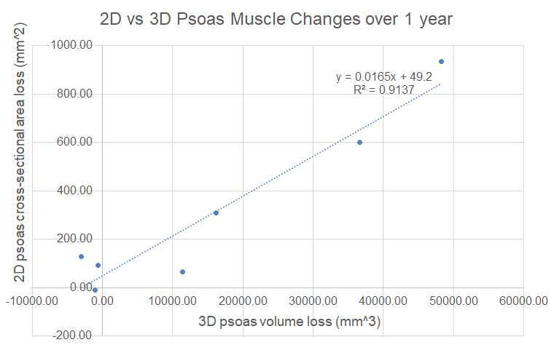
Results:
A linear relationship is seen between the 2D & 3D method (R²=0.91, p<0.001)
Notes:
. When compared against an established 2D manual segmentation method, there was a strong correlation in the changes measured between patients’ initial and subsequent follow up scan results.

Slide 10
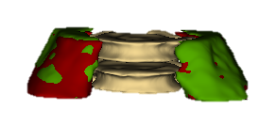
Conclusion:
Initial results look promising:
Fast - 0.175s to segment the psoas muscle
Accurate - 89% accuracy
Reliable - Potential for greater sensitivity to small muscle changes
Rapid automated psoas segmentation enables future study of large datasets → directing research into better treatments → better patient care!
Next Steps: integration into patient EPR with graphic, temporal sarcopenia trajectory
Kelly Fullerton
kelly.fullerton@sri.utoronto.ca
Notes:
Automatic segmentation of the psoas muscle was successfully applied to a clinical data set. This approach will enables larger datasets to be studied to understand the progression of sarcopenia in routine CT imaging. The accuracy and speed of this 3D method may yield greater sensitivity to small muscle changes in sarcopenia quantification. Our next steps will be to incorporate this method into a clinical tool that can be used to study sarcopenia in a large cohort of prostate cancer patients..

