Slide 1
Minimally Invasive vs. Open Thoracolumbar Surgery for Lumbar Spinal Stenosis in Patients with Diabetes – A CSORN Study Kalpesh Hathi BScKin, Erin Bigney MA, Eden Richardson BA, Tolu Alugo MD, MSc, DPCOAI, CIME, DCAPM, FIPP, CIPS, ASRA-PMUC, Dana El-Mughayyar BSc, Amanda Vandewint BSc, Neil Manson MD FRCSC, Edward Abraham MD FRCSC, CSORN Investigators, Najmedden Attabib MD FRCSC

Slide 2
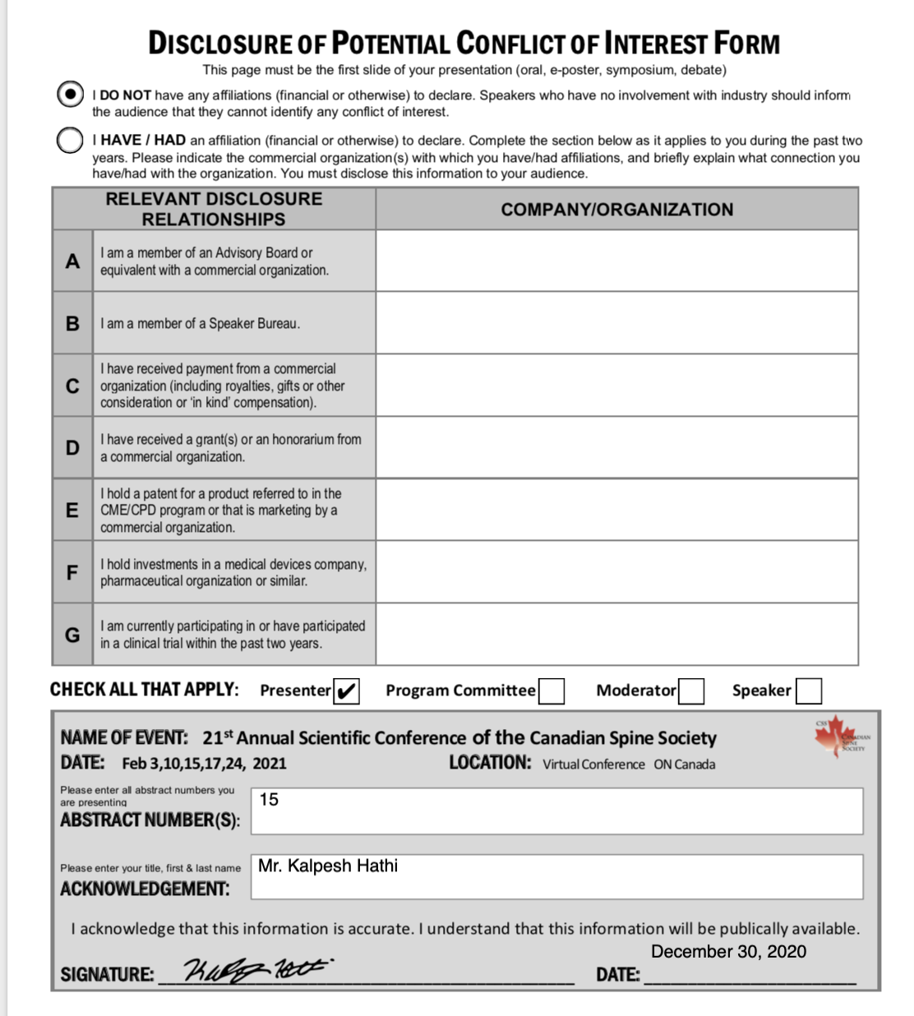

Slide 3
Background
Patients with diabetes tend to have worse outcomes following spine surgery.
Minimally invasive surgical approaches (MIS) for the lumbar spine are associated with less soft tissue damage and favorable peri-operative outcomes.
MIS compared to OPEN surgery for patients with diabetes and lumbar spinal stenosis (LSS) has not yet been studied.

Slide 4
Objectives
Compare outcomes of patients with diabetes undergoing MIS vs. OPEN lumbar decompression alone for LSS.
Compare outcomes of patients with diabetes undergoing MIS vs. OPEN lumbar decompression with fusion for LSS.

Slide 5
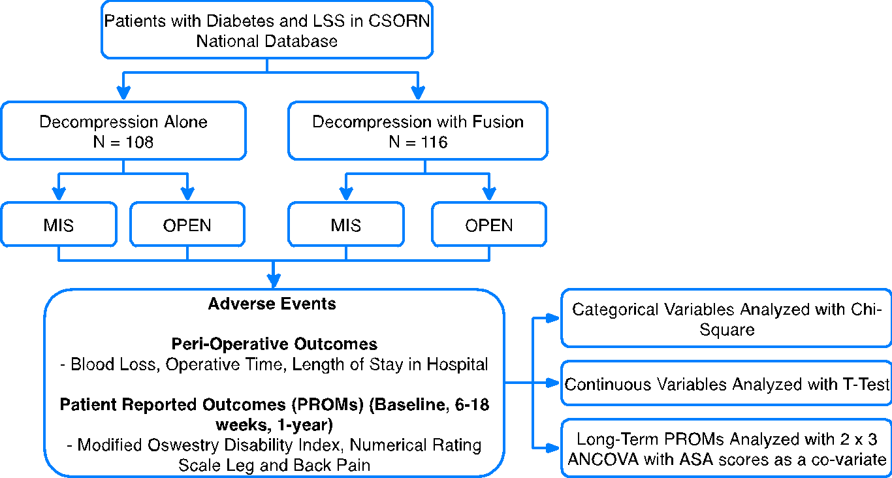
Methods

Slide 6
Results
Decompression Alone
 |  | MIS (N=58) |  | OPEN (N= 58) |  | P- Value
 |  | Mean | SD | Mean | SD
Blood Loss (mL) |  | 82.27 | 121.81 | 182.04 | 208.83 | 0.002*
OR Time (mins) |  | 93.15 | 33.38 | 99.82 | 37.46 | 0.325
LOS (Days) |  | 1.30 | 1.82 | 2.45 | 2.81 | 0.008*
% of Patients who had an AE |  | 36.2% | - | 29.3% | - | 0.429
Infection/Wound Drainage (%) |  | 1.7% | - | 0% | - | -
Decompression with Fusion
 |  | MIS (N= 54) |  | OPEN (N= 54) |  | P- Value
 |  | Mean | SD | Mean | SD
Blood Loss (mL) |  | 230.0 | 176.74 | 474.23 | 369.10 | 0.001*
OR Time (mins) |  | 201.51 | 65.10 | 186.49 | 71.56 | 0.270
LOS (Days) |  | 4.19 | 3.08 | 5.42 | 3.33 | 0.026*
% of Patients who had an AE |  | 18.5% | - | 42.6% | - | 0.007*
Infection/Wound Drainage (%) |  | 1.9% | - | 5.6% | - | -
* = p < 0.05

Slide 7
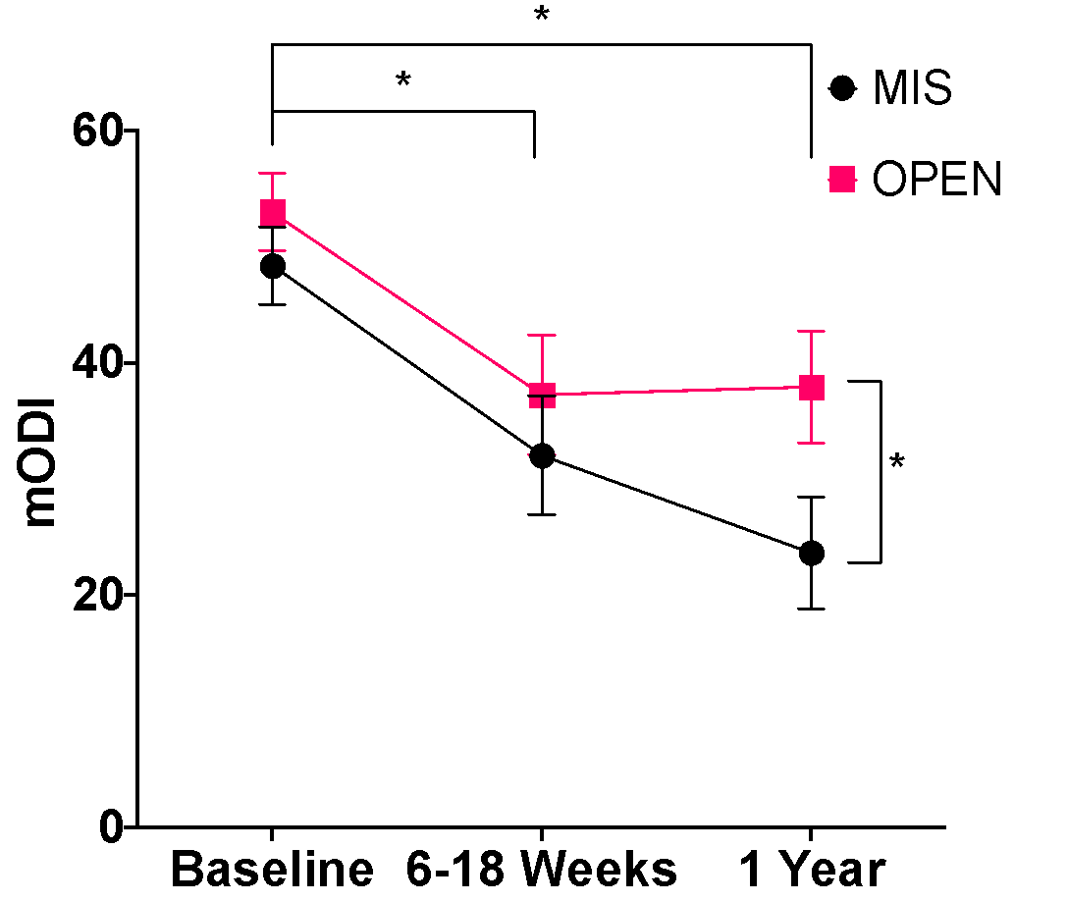
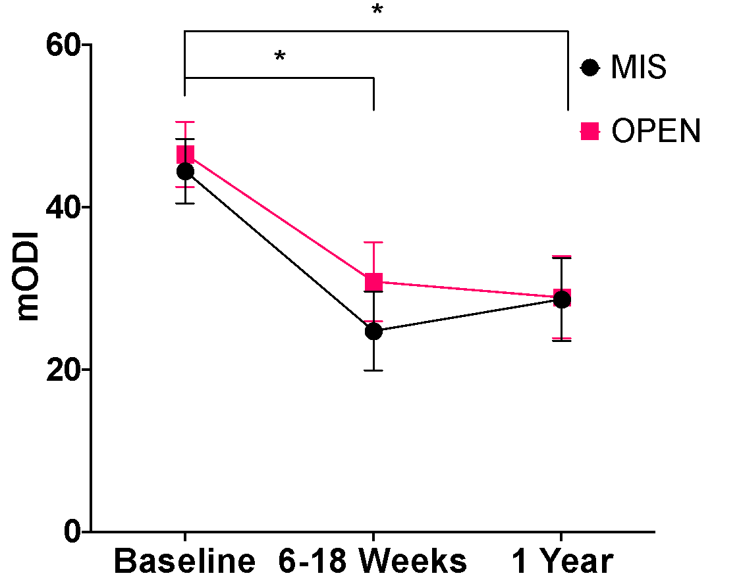
Results: mODI
Decompression Alone
Decompression with Fusion
* = p < 0.05

Slide 8
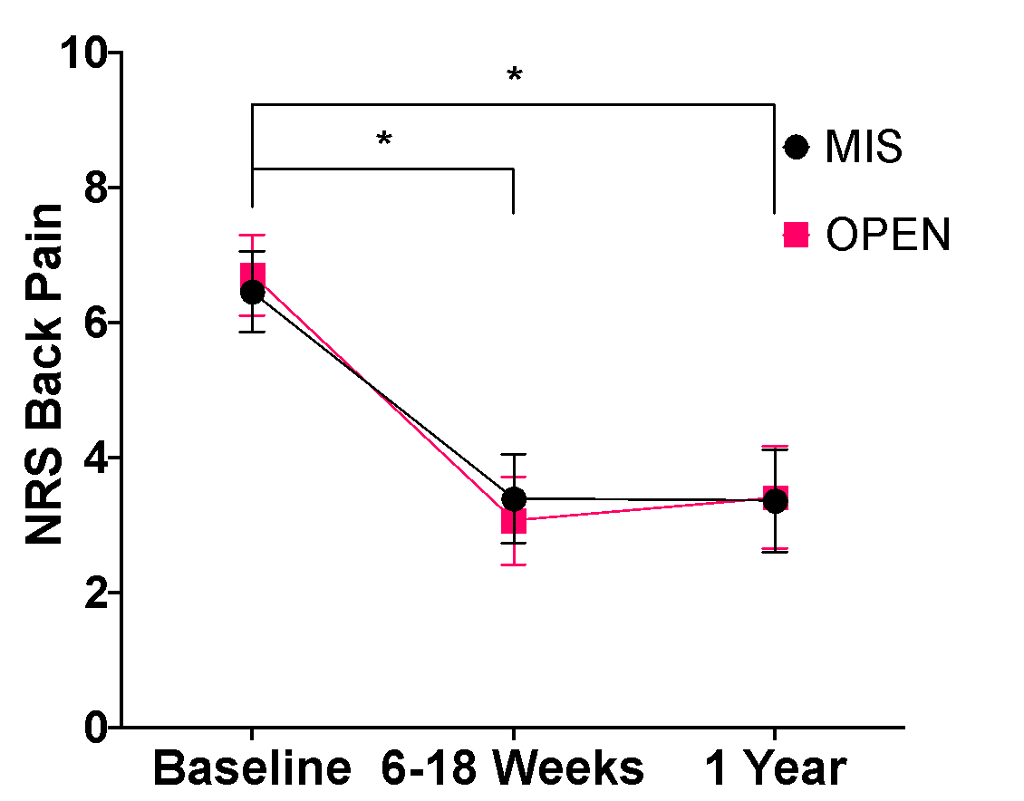
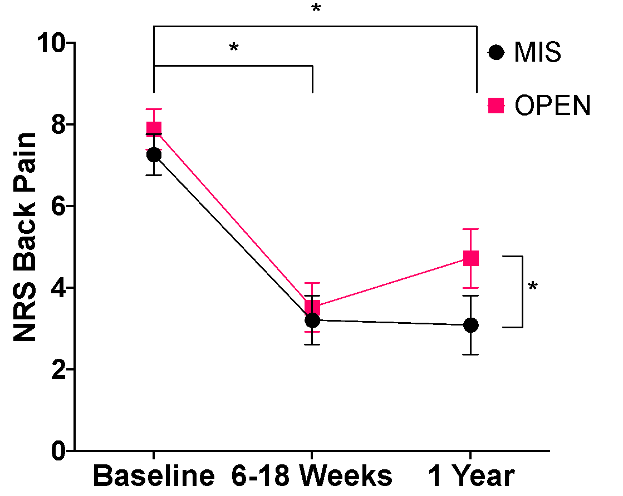
Results: NRS Back
Decompression Alone
Decompression with Fusion
* = p < 0.05

Slide 9
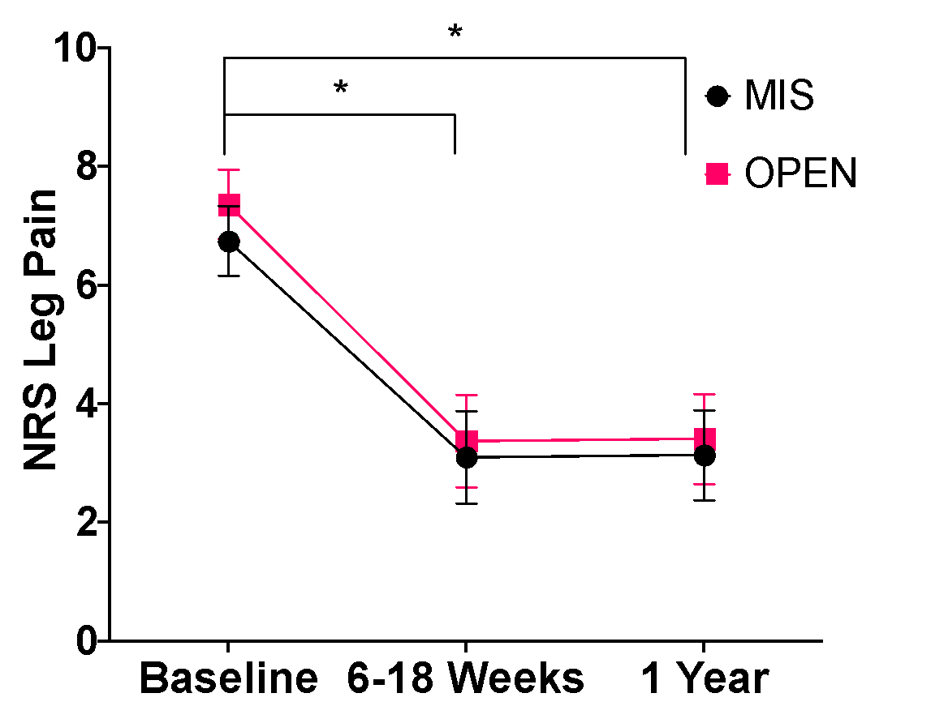
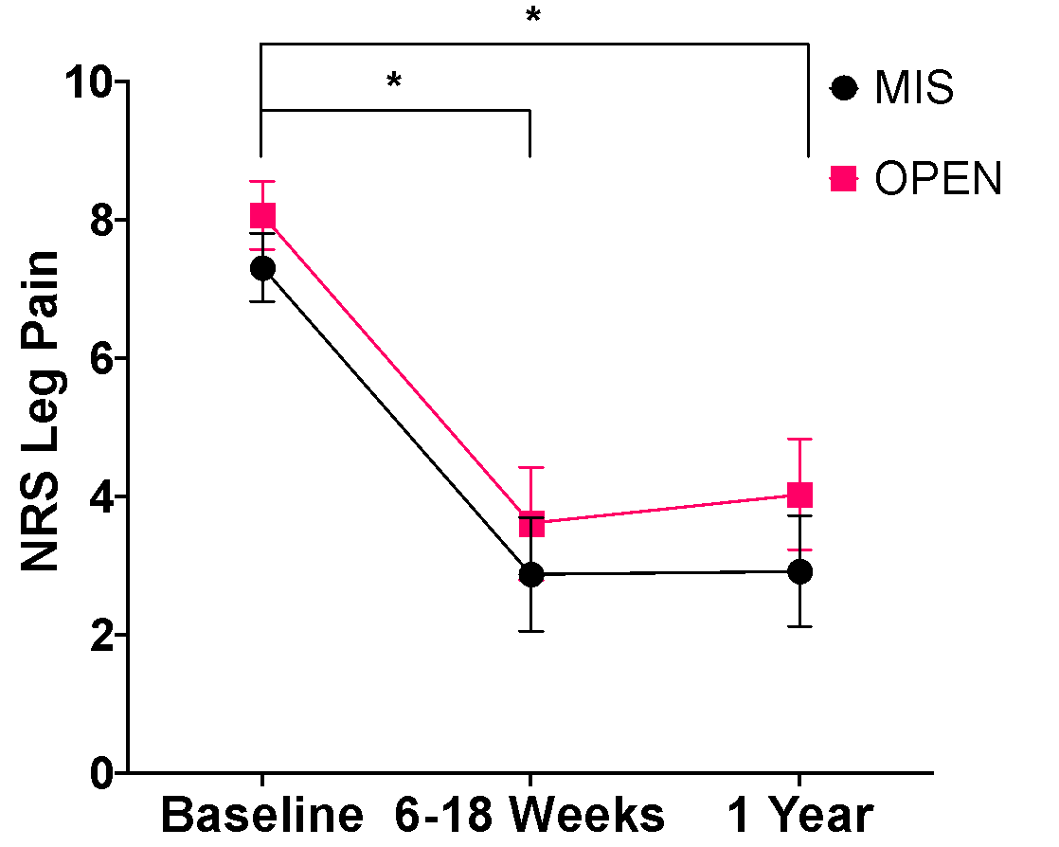
Results: NRS Leg
Decompression Alone
Decompression with Fusion
* = p < 0.05

Slide 10
Conclusions
MIS approaches showed significantly less blood loss, shorter length of stay in hospital, and less patients with adverse events.
MIS decompression with fusion resulted in significantly lower ODI and NRS back pain at 1 year follow-up.
MIS approaches offer advantages for patients with diabetes undergoing decompression with fusion for LSS.

