Slide 1






Paediatric Health-Related Quality of Life Outcomes Following Surgery for Adolescent Idiopathic Scoliosis
Jack Kerr BSc, Edward Abraham MD FRCSC, Amanda Vandewint BSc, Erin Bigney MA, Jeffrey Hebert PhD, Eden Richardson BA, Dana El-Mughayyar BSc, Jill Chorney PhD, Ron El-Hawary MD MSc FRCSC, PORSCHE Study Group, Neil Manson MD FRCSC

Slide 2
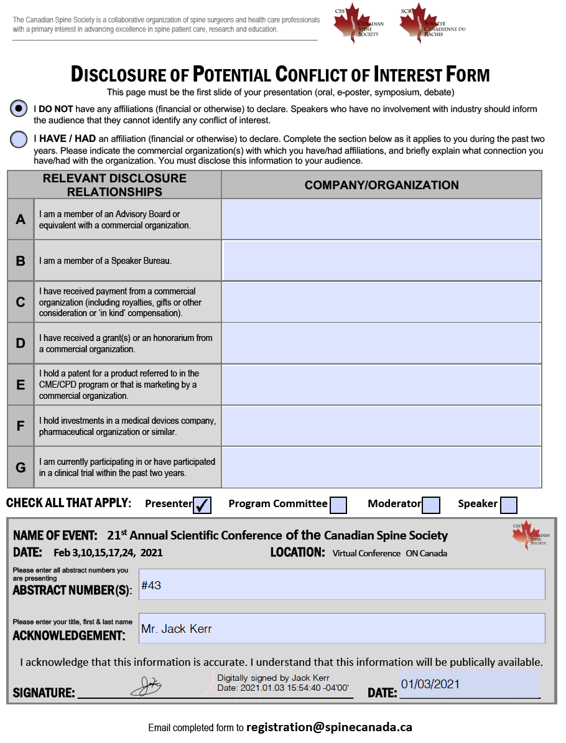

Slide 3
Background
While the average patient experiences improvements in pain and disability following surgery, large variability in clinical outcomes exist, suggesting that many patients may not fit an “average” recovery trajectory.
No pediatric study has explored health-related quality of life (HRQOL) trajectory subgroups in Adolescent Idiopathic Scoliosis (AIS) patients.
Objective: to identify patient trajectories of recovery defined by change in HRQOL following surgery for AIS.

Slide 4
Methods
Study Design: A retrospective analysis of prospectively collected data.
Patient Population: Adolescent patients who had spinal fusion for AIS and were enrolled in the Post-Operative Recovery following Spinal Correction: Home Experience (PORSCHE) study.
Study Outcome: Physical Health and Psychosocial Health scores using the Pediatric Quality of Life Inventory – version 4 SF15 (PedsQL-4.0).
Data Collection Time Points: Preoperative Baseline
Postoperative: 1, 3, 6, and 12 months
Statistics: A group-based trajectory analysis was performed. Means were then compared to established healthy baseline (Varni et al., 2001).

Slide 5
Methods
The Bayesian information criterion was used to identify clinically relevant trajectories with minimum group sizes of 5%.
Models were subsequently evaluated with 4 a priori diagnostic criteria:
A minimum average posterior probability of individual group membership of 0.7 for each group;
Obtaining close correspondence between the estimated probability of group membership and the proportion of participants assigned to each group based on the posterior probability;
Reasonably tight confidence intervals around estimated group membership probabilities;
Minimum odds of correct classification >5.

Slide 6
Results
N=190 |  | %
Sex | Female | 86.5
Brace | Yes | 30.0
 | Mean | SD
# of Levels | 10.66 | 2.26
Age | 14.63 | 1.86
Magnitude of Curvature (Most Severe) | 64.74 | 13.04

Slide 7
Results:
Physical Health
Trajectory Groups
Group Membership
Healthy
Baseline
Range
(Mean ± SD)
1 – Moderate start, minor decline, high finish; 2 – High start, moderate decline, high finish; 3 – High start, major decline, high finish

Slide 8
Results:
Psychosocial Health
Trajectory Groups
Group Membership
Healthy
Baseline
Range
(Mean ± SD)
1 – High start, high finish; 2 – High-moderate start, high finish; 3 – Moderate start, high finish; 4 – Moderate start, moderate finish

Slide 9
Conclusions
Psychosocial health was only impacted by surgery for a small subset of patients (17.5%).
Surgery for AIS results in physical health and psychosocial health quality of life scores comparable to healthy adolescents one year following surgery.

