Slide 1
Clinical and radiographic outcomes of M6-L disc arthroplasty at a single Canadian Centre
Section of Orthopaedic Surgery
Taryn Ludwig – MD/PhD, PGY3
Alex Soroceanu – MD, CM, MPH, FRCSC
Jacques Bouchard – MD, FRCSC, FAAOS
CSS 2021

Slide 2
Disclosure

Slide 3
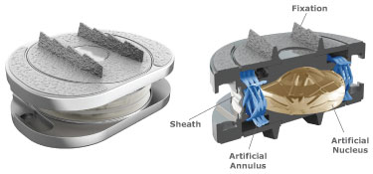
Objective
Canadian and non-industry sponsored outcome data for lumbar disc arthroplasty (LDA) are limited
LDA achieves at least similar clinical outcomes and complication rates compared to fusion (1-3)
Single level, dual level, and hybrid LDA/fusion procedures provide improvement in clinical outcomes at mid- to long-term timepoints (4-6)
The M6-L is a second-generation non-articulating LDA prosthesis
M6-L is used at our centre under Health Canada exemption
The objective of this study is to provide clinical and radiographic outcome data for patients undergoing single level, dual level, or hybrid fusion+LDA procedures with the M6-L prosthesis
http://www.spinalkinetics.com/m6-l/m6-l-overview/
1. Cui et al. J Orthop Surg Res. 2018;6:1–12, 2. Zigler J et al. Global Spine J. 2018;8(4):413–23. 3. Formica M et al. J Orthop Traumatol. 2017;18(3):197–215. 4. Formica C et al. Eur Spine J [Internet]. 2019. https://doi.org/10.1007/s00586-019-06100-3. 5. Scott-Young M et al. Spine (Phila Pa 1976). 2020;45(1):18–25. 6. Scott-Young M et al. Spine (Phila Pa 1976). 2017;43(2):75–81.

Slide 4
Methods
Retrospective cohort:
All patients receiving single level, dual level, or hybrid M6-L procedures by a single surgeon with extensive LDA experience from October 2013 – June 2019
CSORN database (not all patients participated):
Demographic data: age, BMI
Length of stay (LOS)
Complications
Patient reported outcomes: VAS back, VAS leg, ODI
Pre-op, 3 months, 1 year, 2 years, 3+ years post-op
Chart review:
Complications
Radiographic outcomes: assessed at last available imaging
Segmental ROM
Global lumbar lordosis
Notes:
Add inclusion/exclusion criteria to appendix slide or bubble here?
excluded if they had bone mineral density T-score less than -1.0 - -1.5, deformity, instability, facet arthrosis, stenosis, isolated radicular compression symptoms, inflammatory arthritis, or increased approach-related risk due to previous abdominal surgery

Slide 5
Patient Demographics
 |  | Single level | Dual level | Hybrid
Patients (N) |  | 48 | 10 | 40
 | Male | 40% | 60% | 45%
 | Female | 60% | 40% | 55%
Age (SD) | (p = 0.016) | 39.2 (5.9) | 36.2 (5.0) | 41.8 (6.2)
BMI (SD) | (p = 0.79) | 25.5 (3.1) | 25.5 (1.8) | 26.4 (7.7)
Symptomatic level |  | L3/4: 1 L4/5: 8 L5/S1: 39 | L3-5: 2 L4-S1: 8 | L3-5: 2 L3-S1: 1 L4-S1: 37
Number in CSORN database | Baseline | 34 | 6 | 24
 | 3 months | 25 (74%) | 5 (83%) | 17 (71%)
 | 1 year | 23 (68%) | 3 (60%) | 14 (58%)
 | 2 years | 13 (38%) | 1 (17%) | 10 (42%)
 | 3+ years | 9 (26.4%) | 0 | 5 (21%)
Length of stay, days (SD) | (p = 0.06) | 1.5 (0.8) | 1.7 (0.8) | 2.8 (3.7)

Slide 6
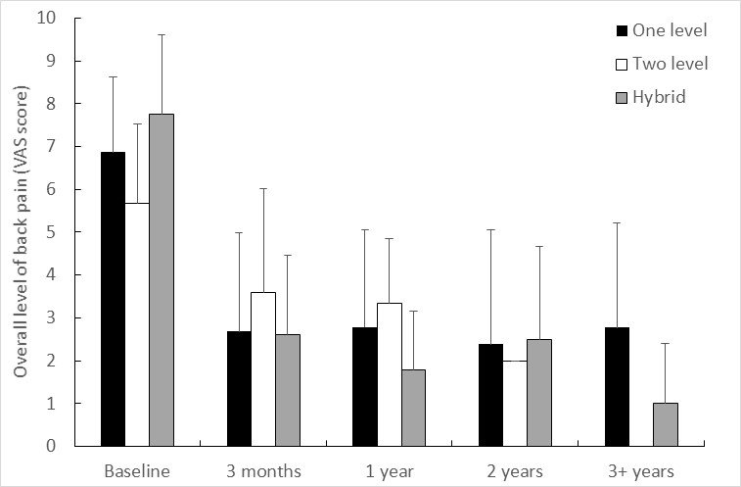
Clinical Outcomes
Statistical comparisons within groups not appropriate given small sample size
For pooled cohort of single, dual, and hybrid procedures:
VAS back pain by procedure over time:
 | Pre-op |  | 1 year post-op | p-value
VAS back pain | 6.9 |  | 2.4 | p < 0.0001
VAS leg pain | 4.3 |  | 1.6 | p < 0.0001
ODI | 43.6 |  | 15.9 | p < 0.0001

Slide 7
Radiographic Outcomes
No significant differences in lordosis between groups
No prosthesis subsidence was observed in this study
 | Single level | Dual level | Hybrid
Patients (N) | 46 | 10 | 38
Mean follow-up in months (range) | 17.5 (0.6 – 60.2) | 13.0 (4.2 – 42.3) | 19.8 (1.0 – 58.1)
Lordosis (°) | 60.8 (8.8)° | 64.7 (10.5)° | 60.0 (10.3)°
p = 0.38
ROM (°) | 9.1 (4.1)° | Upper: 10.1 (4.3)° | 9.1 (5.4)°
 |  | Lower: 7.0 (4.3)°
Notes:
Assessed by 1 author, all XR reviewed at clinical follow up by senior author
For single level arthroplasty, 2 patients had no imaging available post-operatively. An additional 3 patients did not have full lumbar spine films so lordosis could not be measured. One patient did not have flexion-extension films so ROM could not be measured. For dual level arthroplasty, all patients had available imaging . For hybrid procedures, 2 patients had no imaging available post-operatively. I cannot find the reference I had that <3 degrees is considered fused so removed this statement:
“After dual-level arthroplasty, 1 patient (10%) had ROM less than 3° at both operated levels, and 1 patient (10%) had ROM less than 3° at the upper level”
agree

Slide 8
Complications
There were no device related complications observed in this study.
 |  | Single level | Dual level | Hybrid
Peri-operative | Urinary retention | 1 |  | 2
 | Post sympathectomy symptoms | 1 | 1 | 1
 | Ileus |  | 1 | 1
 | Retrograde ejaculation |  |  | 1 (transient)
 | Vascular injury |  |  | 1 (iliac vein)
 | Other |  |  | 1 seroma 1 delirium
 | Total peri-operative complication rate | 4.2% | 20% | 20%
Post-operative | Adjacent segment degeneration | 1
 | Facet arthropathy | 1
 | Other |  |  | 1 foot drop NYD* 1 DVT 1 end plate fracture 1 pericarditis
 | Total post-operative complication rate | 4.2% |  | 10%
Re-operation | Trauma | 2
 | Neurologic symptoms |  |  | 2 foraminotomy at fused level
 | Total re-operation rate | 4.2% |  | 5%
*: neurologically intact until 2 years post-operatively, foot drop occurred after a fall. Unrelated to M6-L prosthesis.
Notes:
Single level:
Peri-operative: 4.2%
1 urinary retention in hospital, 1 patient had post sympathectomy symptoms.
Post operative: 4.2%
1 patient had adjacent segment degeneration, 1 patient had facet arthropathy
Re-operation: 4.2%
1 fall causing bilateral pars fracture requiring fixation, 1 osteophyte fracture requiring decompression and partial implant excision
Dual level
Peri-operative: 20%
1 post-op ileus, 1 transient sympathectomy symptoms.
Hybrid
Peri-operative: 20%:
1 transient retrograde ejaculation, 1 iliac vein injury at the fusion level, 1 post sympathectomy symptoms, 1 retroperitoneal seroma treated by percutaneous drainage, 2 urinary retention, 1 ileus, 1 had post-operative delirium.
Post-operative: 10%
1 foot drop, 1 deep vein thrombosis, 1 endplate fracture causing mild lateral recess stenosis, 1 recurrent pericarditis.
Reoperation: 5%
two patients underwent a foraminotomy of L5 at the fused level, 8 months and 2 years after a hybrid L4-S1 procedure.

Slide 9
Discussion
First study presenting outcomes after treatment with the M6-L LDA prosthesis in a Canadian population
Limitations
Small population size:
Vast referral area = lower follow-up rate due to travel requirement
Younger population = lower follow-up rate due to more transient laborers
Radiographic outcomes at last follow-up
Non-standardized timepoint
Significant improvement in clinical outcomes
Unable to compare procedures due to population size
Mid-term follow-up: longer follow-up needed
Continued assessment of clinical outcomes as more patients receive the M6-L prosthesis will help increase the sample size for future studies

Slide 10
Conclusions
This study demonstrates that the M6-L lumbar disc arthroplasty prosthesis is safe and effective for treatment of discogenic back pain in this Canadian population
Significant improvement in patient reported outcome scores post-operatively
Complication rates: 4-20%
No serious device related adverse events
Questions/feedback? Please get in touch!
Taryn Ludwig: teludwig@ucalgary.ca
Jacques Bouchard: bouchard@ucalgary.ca

