Slide 1
Implant-Related Complications Using Uniaxial Implants in Pediatric Spinal Deformity Surgery
¹Department of Orthopaedic Surgery, The Hospital for Sick Children
²Department of Physical Therapy, University of Toronto
Masayoshi Machida, M.D¹
Brett Rocos, M.D¹
David E. Lebel, M.D, Ph.D¹
Karl Zabjek, BSc, MSc, Ph.D²
Reinhard Zeller, M.D, FRCSC¹

Slide 2
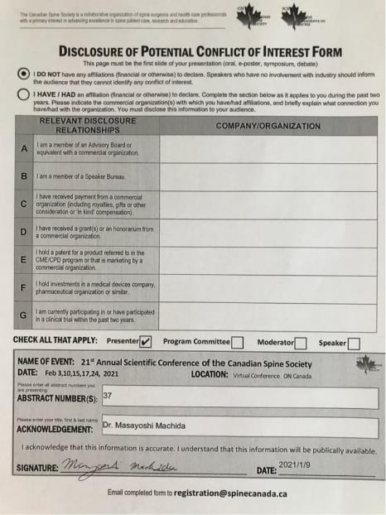

Slide 3
Background and Objective
Deformity surgery is challenging and complex with implant related complication rates such as pullout and implant fracture [1-3].
To our knowledge there are no studies which investigated the clinical impact of implant-related complications on surgical outcomes using uniaxial implants, screws and hooks, in disease-specific cohorts.
Objective:
To evaluate the incidence of implant-related complications in pediatric spinal deformities treated with posterior spinal fusion using uniaxial implants.

Slide 4
Material and Method
Study design: case series study
Patients with pediatric spinal deformities that underwent PSF with
uni-axial screws in our institution between 2006 and 2019.
Inclusion criteria
Age < 18 years at the time of surgery
Exclusion criteria
Patients treated other procedure (e.g. growing rod…)

Slide 5
Result: The all patients demographics
 | Total (N=595) | Idiopathic (N=449) | Congenital (N=24) | Neuromuscular (N=38) | Syndromic (N=84)
Age (years) | 14.5±2.4 | 14.9±1.7 | 9.1±4.6 | 13.9±2.1 | 14.2±2.6
Follow-up (years) | 2.4±1.5 | 2.4±1.4 | 3.6±2.1 | 2.1±1.8 | 2.6±1.7
Average Number of rods | 2.1±0.3 | 2.0±0.2 | 2.1±0.3 | 2.3±0.4 | 2.2±0.4
Average number of uniaxial pedicle screws | 15.3±4.8 | 16.2±3.7 | 5.8±1.2 | 15.3±6.5 | 13.0±5.6
Average number of hooks | 5.4±2.9 | 4.8±2.3 | 3.7±4.4 | 7.8±3.3 | 7.6±3.5
Average number of clips | 20.7±4.1 | 21.1±2.9 | 9.7±5.4 | 23.7±4.5 | 20.6±3.9
Average number of transverse bars | 2.1±0.5 | 2.1±0.3 | 1.0±1.0 | 2.5±0.5 | 2.3±0.6
Cases of lumbosacral fusion | 15 | 0 | 2 | 13 | 0

Slide 6
Result: All Implant failure cases
 | Total (N=595) | Idiopathic (N=449) | Congenital (N=24) | Neuromuscular (N=38) | Syndromic (N=84)
Implant failure | 7 (1.2%) | 3 (0.7%) | 1 (4.2%) | 1 (2.6%) | 2 (2.4%)
Revison cases | 4 (0.7%) | 0 (0%) | 1 (4.2%) | 1 (2.6%) | 2 (2.4%)

Slide 7
Result: Implant failures (f/u > 2 years): Non-union or isolated mechanical failure ? (Isolated mechanical failure = implant failure w/o loss of correction and solid fusion)
 | All Complication cases |  |  | Revision cases
 | Total | Failure | Failure+ Non-union | Total
Rod Breakage | 1 | 0 | 1 | 1
Uniaxial screws Loosening Breakage | 1 0 | 0 0 | 1 0 | 1 0
Iliac screws Loosening Breakage | 1 1 | 1 1 | 0 0 | 1 1
Hooks Complete slippage Partial slippage | 1 1 | 1 1 | 0 0 | 0 0
Clips Loss of fixation Breakage | 0 0 | 0 0 | 0 0 | 0 0
Transverse bars Dislocation Breakage | 0 1 | 0 1 | 0 0 | 0 0
Total (N=389) Idiopathic (N=294) Congenital (N=18) Neuromuscular (N=22) Syndromic (N=55) | 7 (1.8%) 3 (1.0%) 1 (5.6%) 1 (4.5%) 2 (3.6%) | 5 (1.3%) 3 (1.0%) 1 (5.6%) 1 (4.5%) 0 (0%) | 2 (0.5%) 0 (0%) 0 (0%) 0 (0%) 2 (3.6%) | 4 (1.0%) 0 (0%) 1 (5.6%) 1 (4.5%) 2 (3.6%)

Slide 8
Discussion
The overall implant failure rate was 1.2% (7/595). At a 2 years f/u 4 revision surgeries were performed (2 related to non-unions).
Uniaxial screws potentially decrease the level of stress at the bone-implant interface during the locking process while retaining the advantages of monoaxial screws with respect to better rotational control [4].
The design of the uniaxial and polyaxial screws permit head angulation and allows the screw head to align with the rods and to adapt to the pre-bent rod, thus reducing rod reduction forces and enhancing rod resistance to slip compared to monoaxial screws, and significant increase in the axial slip strength [5].

Slide 9
Conclusion
The overall rate of implant-related complications was 1.2 % with a revision rate of 0.7%.
Implant failure due to non-union happened in 0.5% of our patients.
This data is useful for the preoperative discussion about risks and benefits of a posterior spinal fusion in paediatric spinal deformities.

Slide 10
References
1) Clin J, Le Navéaux F, Driscoll M, et al. Biomechanical comparison of the load-sharing capacity of high and low implant density constructs with three types of pedicle screws for the instrumentation of adolescent idiopathic scoliosis. Spine Deform. 2019 Jan;7(1):2-10.
2) Davis L Reames , Justin S Smith, Kai-Ming G Fu, et al. Complications in the Surgical Treatment of 19,360 Cases of Pediatric Scoliosis: A Review of the Scoliosis Research Society Morbidity and Mortality Database. Spine (Phila Pa 1976). 2011 Aug 15;36(18):1484-91
3) Al-Mohrej OA, Aldakhil SS, Al-Rabiah MA, et al. Surgical Treatment of Adolescent Idiopathic Scoliosis: Complications. Ann Med Surg (Lond).2020 Feb 24;52:19-23.
4) Essig DA, Miller CP, Xiao M, et al. Biomechanical comparison of endplate forces generated by uniaxial screws and monoaxial pedicle screws. Orthopedics 2012 Oct;35(10):e528-32.
5) Serhan H, Hammerberg K, O'Neil M, et al. Intraoperative techniques to reduce the potential of set-screw loosening in long spinal constructs: a static and fatigue biomechanical investigation. J Spinal Disord Tech. 2010 Oct;23(7):e31-6.

