Slide 1
Increased Upper Thoracic Curve Vertebral Rotation Is Associated with Shoulder Imbalance After Posterior Spinal Fusion for Adolescent Idiopathic Scoliosis
¹Department of Orthopaedic Surgery, The Hospital for Sick Children
²Department of Physical Therapy, University of Toronto
Masayoshi Machida, M.D¹
Karl Zabjek, BSc, MSc, Ph.D²
Brett Rocos, M.D¹
David E. Lebel, M.D, Ph.D¹
Reinhard Zeller, M.D, FRCSC¹

Slide 2
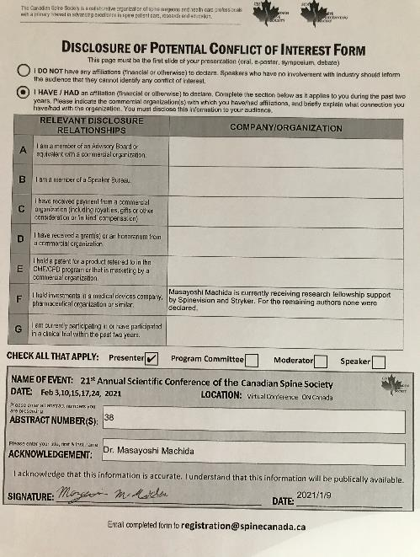
COI

Slide 3
Background and Objective
Scoliosis is a three-dimensional (3D) deformity consisting of coronal, sagittal, and axial rotation of the spinal column [1,2].
It has been increasingly recognized that the correction of apical vertebral rotation (AVR) and correcting shoulder balance are important indicators of successful correction [3-8].
Objective:
to quantify the effect of PSF on AVR and shoulder balance during and over 2 years follow up with sterEOS.
to determine the relationship between the global and local indices of spinal alignment with shoulder balance both pre and post-operatively.

Slide 4
Material and Method
Study design: case series study
Patients with AIS that underwent PSF in our institution between 2009 and 2017.
Inclusion criteria
Age < 18 years at the time of surgery
Minimum 2-years of follow-up and sterEOS
sterEOS images with reproducible shoulder assessment landmarks
Exclusion criteria
patients underwent revision or anterior surgery
Radiographic measurements were taken at 1week postoperative and final follow-up.
Statistic analysis: Pearson product-moment correlation

Slide 5
Result
Table: the patients demographics
Parameters | Mean± SD or n (%) N=66
Age (years) | 14.8±1.5
Sex Female Male | 63 (95%) 3 (5%)
Risser sign Risser 0 Risser 1 Risser 2 Risser 3 Risser 4 Risser 5 | 4 (6.1%) 4 (6.1%) 7 (10.6%) 7 (10.6%) 21 (31.8%) 23 (34.8%)
Final follow up (years) | 2.8±1.1
Type of curve Lenke type 1 Lenke type 2 Lenke type 3 Lenke type 4 Lenke type 5 Lenke type 6 | 31 (47.0%) 10 (15.2%) 11 (16.7%) 3 (4.5%) 9 (13.6%) 2 (3.0%)
SD: standard deviation

Slide 6
Result
Table:Radiographical summary of patient cohort
 | Preoperative | Immediate postoperative | 6 months postoperative | Final follow
PT Cobb angle (°) | 32±13 | 18±7.1 | 17±8.1 | 17±7.4
MT Cobb angle (°) | 76±14 | 21±7.3 | 21±7.4 | 22±7.4
TK(T4/12) (°) | 20±16 | 17±9.4 | 18±9.2 | 20±8.5
LL(L1/5) (°) | 48±12 | 43±8.8 | 45±7.4 | 49±7.7
RSHD (mm) | 14±14 | -15±12 | -8.5±11 | -8.3±8.7
PT AVR (°) | 13±3.7 | 8.2±2.5 | 8.8±2.4 | 8.8±2.1
MT AVR (°) | -14±13 | -6.8±7.3 | -7.7±7.0 | -6.8±6.9
PT: proximal thoracic, MT: main thoracic TK: thoracic kyphosis, LL: lumber lordosis RSHD: radiographic shoulder height difference AVR: apical vertebral rotation Value: mean± standard deviation

Slide 7
Result
Table: Correlation coefficient between RSHD at final follow-up and other radiographic parameters at each period
 | RSHD at preoperative | RSHD at immediate postoperative | RSHD at 6 months postoperative | RSHD at final follow up
PT Cobb | r=-0.22 p=0.075 | r=-0.27* p=0.028 | r=-0.34* p=0.0048 | r=-0.37* p=0.0020
MT Cobb | r=-0.16 p=0.20 | r=-0.0083 p=0.95 | r=-0.020 p=0.88 | r=0.061 p=0.63
TK (T4/12) | r=-0.12 p=0.32 | r=0.074 p=0.55 | r=0.010 p=0.94 | r=0.0035 p=0.98
LL (L1/5) | r=-0.043 p=0.73 | r=0.16 p=0.21 | r=-0.15 p=0.22 | r=0.096 p=0.44
PT AVR | r=-0.11 p=0.36 | r=-0.26* p=0.037 | r=-0.29* p=0.017 | r=-0.28* p=0.022
MT AVR | r=0.18 p=0.14 | r=0.10 p=0.41 | r=0.25* P=0.046 | r=0.23 p=0.066

Slide 8
Discussion
Significant correlation between PT and MT AVR and RSHD
→1. larger PT AVR associated with left shoulder elevation
2. the closer MT AVR is to zero the closer to level the
shoulder balance
AVR correlates postoperative shoulder balance and AVR correlates clinically with rib prominence.
→rib prominence pushes the scapula backwards and upwards
with the shoulder sliding laterally and forward.

Slide 9
Conclusion
A significant correlation between postoperative RSHD and PT and MT AVR for AIS was found.
PT Cobb angle and PT and MT AVR associated with shoulder imbalance in AIS.

Slide 10
references
Mehta MH (1973) Radiographic estimation of vertebral rotation in scoliosis. J Bone Joint Surg Br 55:513-520
Perdriolle R, Vidal J (1987) Morphology of scoliosis: three-dimensional evolution. Orthopedics 10:909-915
Kato S, Debaud C, Zeller RD (2017) Three-dimensional EOS analysis of apical vertebral rotation in adolescent idiopathic scoliosis. J Pediatr Orthop 37:543-547
Gotfryd AO, Silber Caffaro MF, Meves R et al (2017) Predictors for postoperative shoulder balance in Lenke 1 adolescent idiopathic scoliosis: a prospective cohort study. Spine Deform 5:66-71
Kuklo TR, Lenke LG, Graham EJ et al (2002) Correlation of radiographic, clinical, and patient assessment of shoulder balance following fusion versus non fusion of the proximal thoracic curve in adolescent idiopathic scoliosis. Spine 27:2013-2020
Asher MA, Burton DC (2006) Adolescent idiopathic scoliosis: natural history and long term treatment effects. Scoliosis 1:2
Carlson BB, Asher MA, Burton DC (2013) Comparison of trunk and spine deformity in adolescent idiopathic scoliosis. Scoliosis 8:2
Sanders AE, Baumann R, Brown H (2003) Selective anterior fusion of thoracolumbar/lumbar curves in adolescents: when can the associated thoracic curve be left unfused? Spine 28:706-713

