Slide 1
Anatomic considerations and functional outcomes of Endoscopic transiliac approach for access to L5-S1 disc and foramen
Nandan Marathe, MD, Spine fellow, Toronto Western Hospital
Prasad Patgaonkar, MD, Director, Indore Spine Centre

Slide 2
Presenter- Nandan Marathe

Slide 3
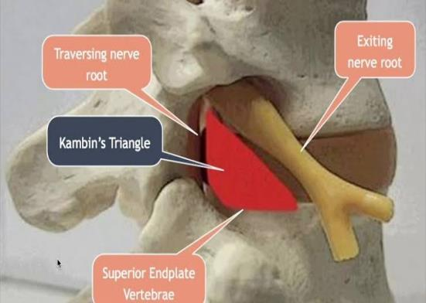
Introduction
Transforaminal endoscopic disc surgery (TELD) has several advantages as compared to open surgery
Efficacy of the procedure is in doubt when the conventional transforaminal approach is obstructed by anatomic barriers. One such difficult to access locations is L5-S1 disc.

Slide 4
Anatomical barriers at L5-S1
High iliac crest
Narrow intertransverse space
Wide facet joint of L5–S1
Thick transverse process
Ala of the sacrum.

Slide 5
-Osman and Marsolais reported a cadaver study on the feasibility of the transiliac approach for L5–S1 in 1997
-They concluded that transiliac approach to the lumbosacral junction is safe.

Slide 6
Methods
This study was carried out over a period of 3 years (2015-2018) at a tertiary care spine centre.
Patients with a disc herniation at L5-S1 level were classified as per the method described by the same author that has been previously published.
We report the functional outcome data obtained during the 2 year postoperative follow-up period.

Slide 7
Case example

Slide 8
Results
TELD was performed through trans-iliac approach in 62 patients
Average operative time: 42 minutes
Mean blood loss: 21 ml
Average LOS- 2 days (day of surgery and the day after).
VAS score improved from 8.31 to 2.25 (P value <0.05)
ODI score also improved from 70.23 to 17.71 (P value <0.05)
No patient deteriorated neurologically
One patient had recurrence at same level managed using selective nerve root block.

Slide 9
The advantages of trans-iliac approach include
Easy removal of central, foraminal or up migrated disc fragment
No damage to the endplate of S1
Reduced risk of exiting nerve injury
Ease of foraminoplasty
Epidural access

