Slide 1




Exploring the ability of radiographic parameters of stenosis severity to predict patient recovery patterns
Johnathan Rose BSc, Neil Manson MD FRCSC, Erin Bigney MA, Amanda Vandewint BSc, Jeffrey Hebert PhD, Dana El-Mughayyar BSc, Eden Richardson BA, Nora Ghallab MSc, Meghan Flood MD, Najmedden Attabib MD FRCSC, The CSORN Investigators, Edward Abraham MD FRCSC

Slide 2


Slide 3
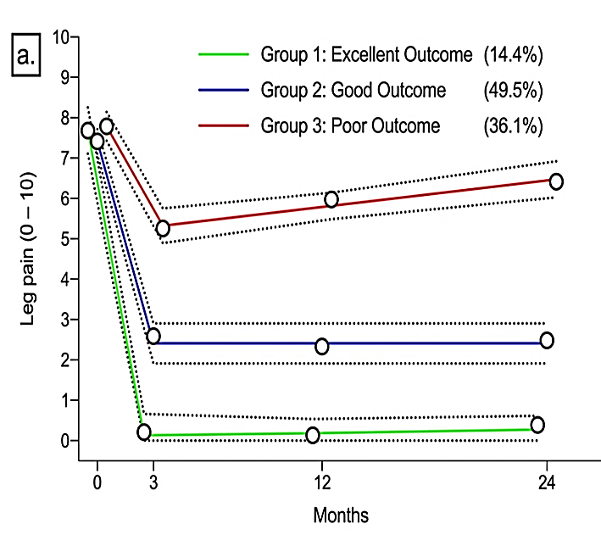
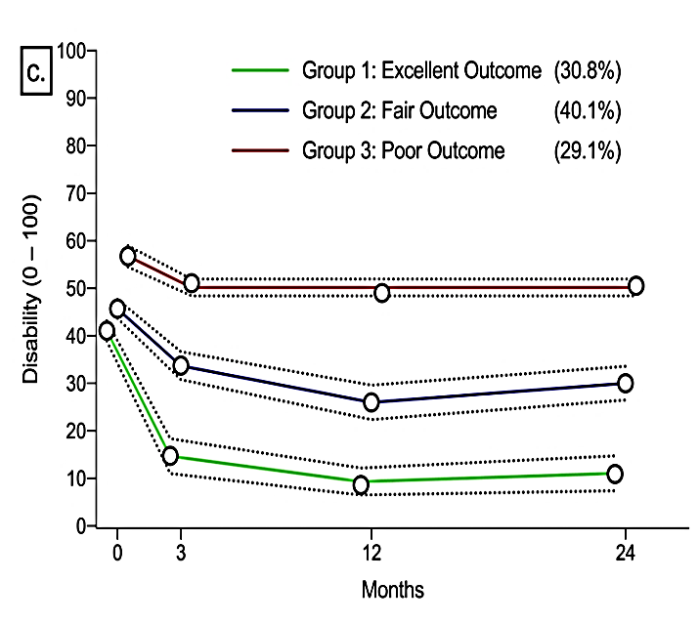
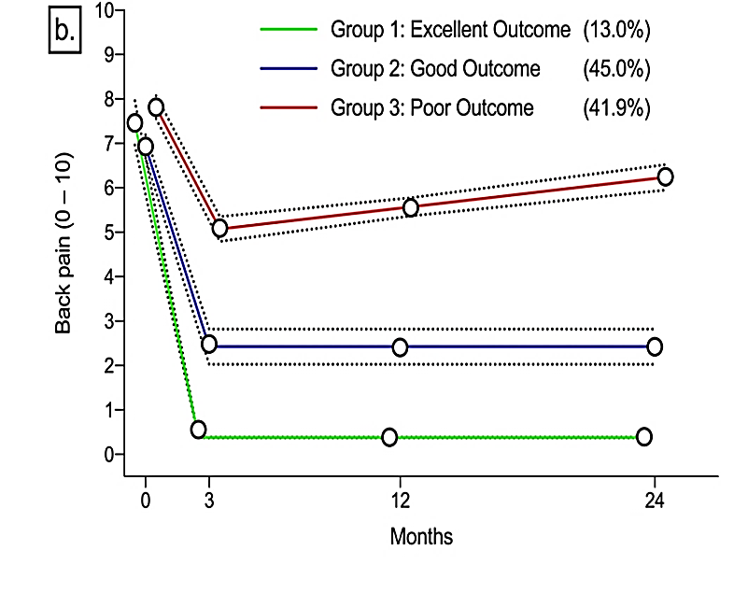
Background
Unique trajectories of leg pain, back pain, and pain-related disability were identified for patients undergoing surgery for lumbar stenosis.
Objective: To explore relations between preoperative severity of pathology and trajectories of pain and disability post-lumbar spine stenosis (LSS) surgery.

Slide 4
Methods
Study Design: Retrospective analysis
Population: Patients (N= 258) in the CSORN registry with LSS previously classified into excellent, good, or poor recovery trajectories.
Predictive Measures of Interest:
Cross-sectional area (CSA)
Degree of central stenosis (CS) using LCCS grading system (Guen et al., 2010).
Degree of foraminal stenosis (FS) through MRI Grading System for Lumbar Foraminal Stenosis (Lee et al., 2010).
Grade level = degree: 1 = mild stenosis, 2 = moderate stenosis, and 3 = severe stenosis.
Statistical Analysis: Multinomial models reporting risk experiencing a good or poor outcome relative to an excellent outcome.

Slide 5
Results: Leg Pain
Severe CS results in a 73% reduced risk of belonging to the poor outcome group.
CSA was not significant.

Slide 6
Results: Leg Pain
Moderate FS results in a 3.4-fold increased risk of belonging to the subgroup with a good recovery pattern.
CSA was not significant.

Slide 7
Results: Back Pain
Patients with severe CS had a 75% reduced risk of belonging to the good recovery subgroup.
Patients with severe CS showed a 68% reduced risk of belonging to the poor recovery subgroup.
CSA and FS were not significant.

Slide 8
Results: mODI
Patients with severe CS had a 69% reduced risk of belonging to the good recovery subgroup.
CSA and FS were not significant.

Slide 9
Limitations
This study was designed as a preliminary investigation of a single site’s imaging despite the original trajectory's done with national data.
This was conducted to investigate any indications of imaging and baseline severity impacting patients recovery patterns.
While significant results were found, the width of confidence intervals suggest the sample size should be increased.

Slide 10
Conclusion
Patients with a higher grade of central stenosis may be benefiting more from surgery than those with mild central stenosis.
Conversely, patients with a lower grade of foraminal stenosis may experience a better surgical outcome for leg pain.

