Slide 1
Sacroiliac joint pain after lumbar spine fusion for degenerative diseases: A systematic review
Jesse Shen, Mathieu Boudier-Reveret, Van Tri Truong, Carl Majdalani, Zhi Wang

Slide 2
Disclosures

Slide 3
Objectives
The objective of this systematic review is to determine the incidence of sacroiliac joint (SIJ) pain after lumbosacral spinal fusion.
The hypothesis is that patients with lumbar fixation extended to the sacrum have higher incidence of SIJ pain compared to those without sacral fixation.
A secondary objective was to determine diagnostic criteria for SIJ pain and sacroiliac dysfunction.

Slide 4
Methods
PROPSERO registered systematic review
Systematic search of the English literature in Embase, Pubmed, Cochrane Library databases.
Articles were included if they reported sacroiliac joint pain after lumbar spine fusion
Newcastle-Ottawa scale was used to appraise the quality of studies

Slide 5
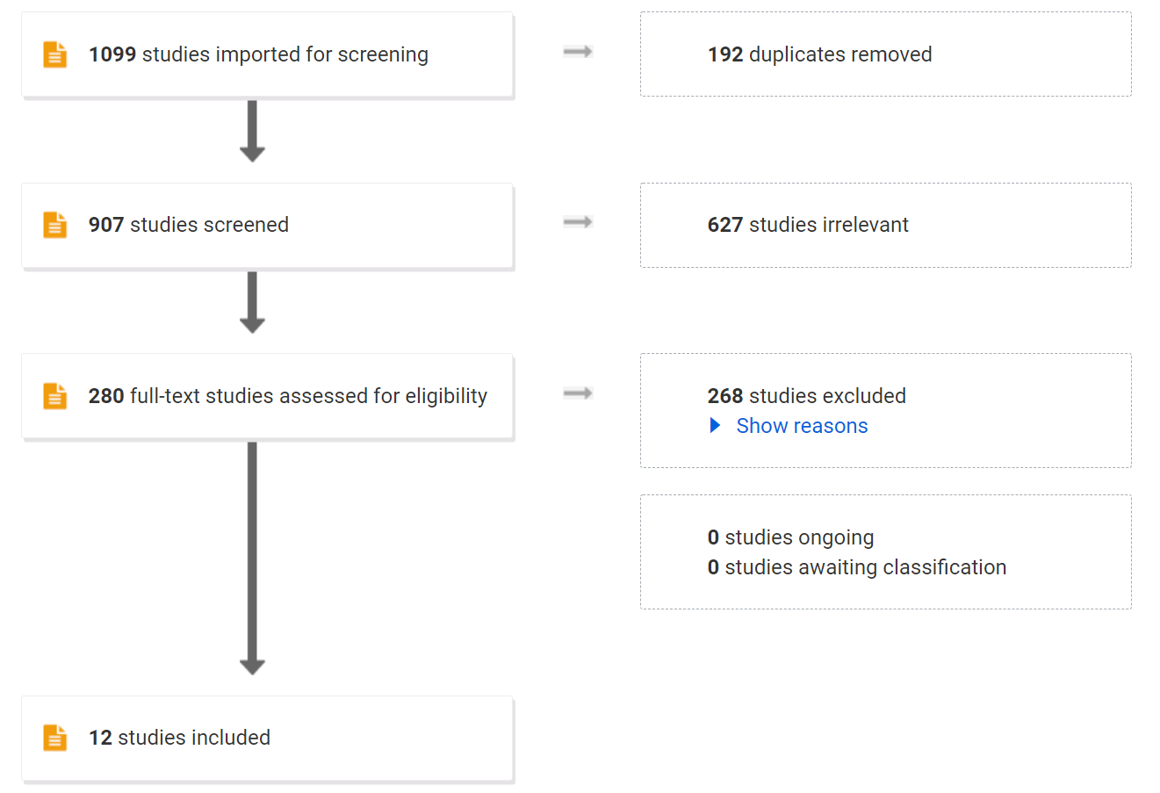

Slide 6
Results
12 articles of low to moderate quality of evidence were included
Incidence of SI joint pain
1292 patients without extension of fusion to sacrum identified
101 patients with SI joint pain identified (7.8%)
1215 patients with extension of fusion to sacrum identified
120 patients with SI joint pain identified (9.8%)

Slide 7
Results
Diagnostic criteria
Heterogenous usage of fluoroscopic guided SI joint block for diagnose of SI joint pain post-operatively
Multiple clinical criteria and scales available for diagnosis of SI joint pain
Heterogeneity
I² statistic of 88%

Slide 8
Conclusion
The current literature on SIJ pain after lumbar spine surgery is of poor quality.
Patients with extended fusion to sacrum may have increased sacroiliac joint pain.
Prospective work is needed to evaluate SI joint pain after lumbosacral spine fusion

