Slide 1
A Canadian Perspective on the Effect of Patient Workload Intensity on Return to Work after Elective Lumbar Spine Surgery
Supriya Singh, Tamir Ailon, Nicolas Dea, , Jerome Paquet, Edward Abraham, Chris Bailey, Henry Ahn, Peter Jarzem, Alex Soroceanu, Michael Johnson, Guy Hogan, Eugene Wai, Andrew Nataraj, Joel Finkelstein, Andrew Glennie, Naz Attabib, Adrienne Kelly, Sean Christie, Hamilton Hall, Raja Rampersaud, Neil Manson, Ken Thomas, Greg McIntosh, Charles Fisher, Raphaële Charest-Morin

Slide 2
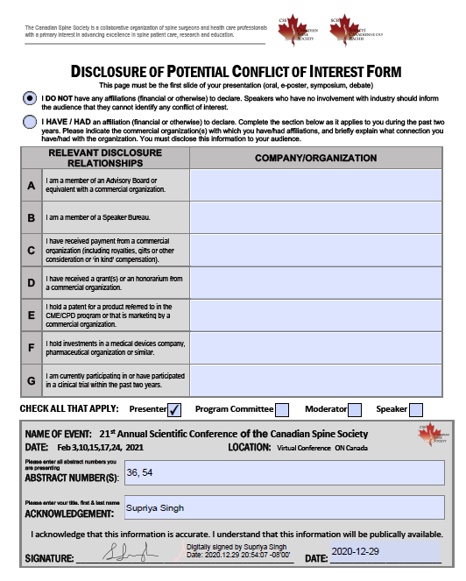

Slide 3
Return to Work (RTW) in the Canadian Population after Elective Lumbar Spine Surgery
This group has previously published the overall rate of RTW is 71%, with a median time to RTW of 6-8 weeks for non fusion and 12 weeks for fusion procedures.
The primary objective of this study was to determine the effects of workload intensity on rate and time to RTW.
The secondary objective was to explore Canadian surgeons’ recommendations about optimal time to RTW stratified by workload intensity

Slide 4
CSORN database
Retrospective study
Enrollment January 2015 – December 2018
Inclusion: employed patients undergoing 1-2 level elective lumbar spine surgery
RTW was analyzed based on workload/daily lifting requirements:
<10 lbs sedentary
<50 lbs light-moderate
>50 lbs moderate-very heavy
Survey to CSORN surgeons about their recommendations for RTW based on workload

Slide 5
Results
Overall results for all surgical groups
(discectomy, laminectomy and fusion surgeries)
Workload Intensity | Number of Patients | Rate of RTW | Median time to RTW
Sedentary | 496 | 84% | 42 days
Light-Moderate | 563 | 81% | 56 days
Heavy-Very Heavy | 164 | 72% | 70 days

Slide 6
Results
Median Time to RTW (days) stratified by workload intensity and type of surgical procedure:
Workload | Discectomy | Laminectomy | Fusion
Sedentary | 38 | 28 | 60
Light-Medium | 45.5 | 49 | 76
Heavy-Very Heavy | 67 | 67 | 73

Slide 7
CSORN Survey Results
Time to RTW stratified by workload and type of surgery as recommended by CSORN surgeons
Workload Intensity | Non fusion surgery (laminectomy/discectomy) | Fusion surgery | Surgeon recommendation
Sedentary | 2-6 weeks | 7-12 weeks | 70%
Light-Moderate | 7-12 weeks | 3-6 months | 63%
Heavy-Very Heavy | 7-12 weeks | 3-6 months | 63%
Response rate 52/60 = 87%
Overall recommendations of surgeons reflected actual times to RTW

Slide 8
Summary
Workload intensity significantly impacts rate and time to RTW post operatively
All three groups (sedentary, light-moderate and heavy-very heavy) had high rates of RTW
Majority of surgeons agree that time to RTW should be tailored according to workload

